Slide 1
Comprehensive Digital Marketing
Project Work

Slide 2

Project given by

Slide 3
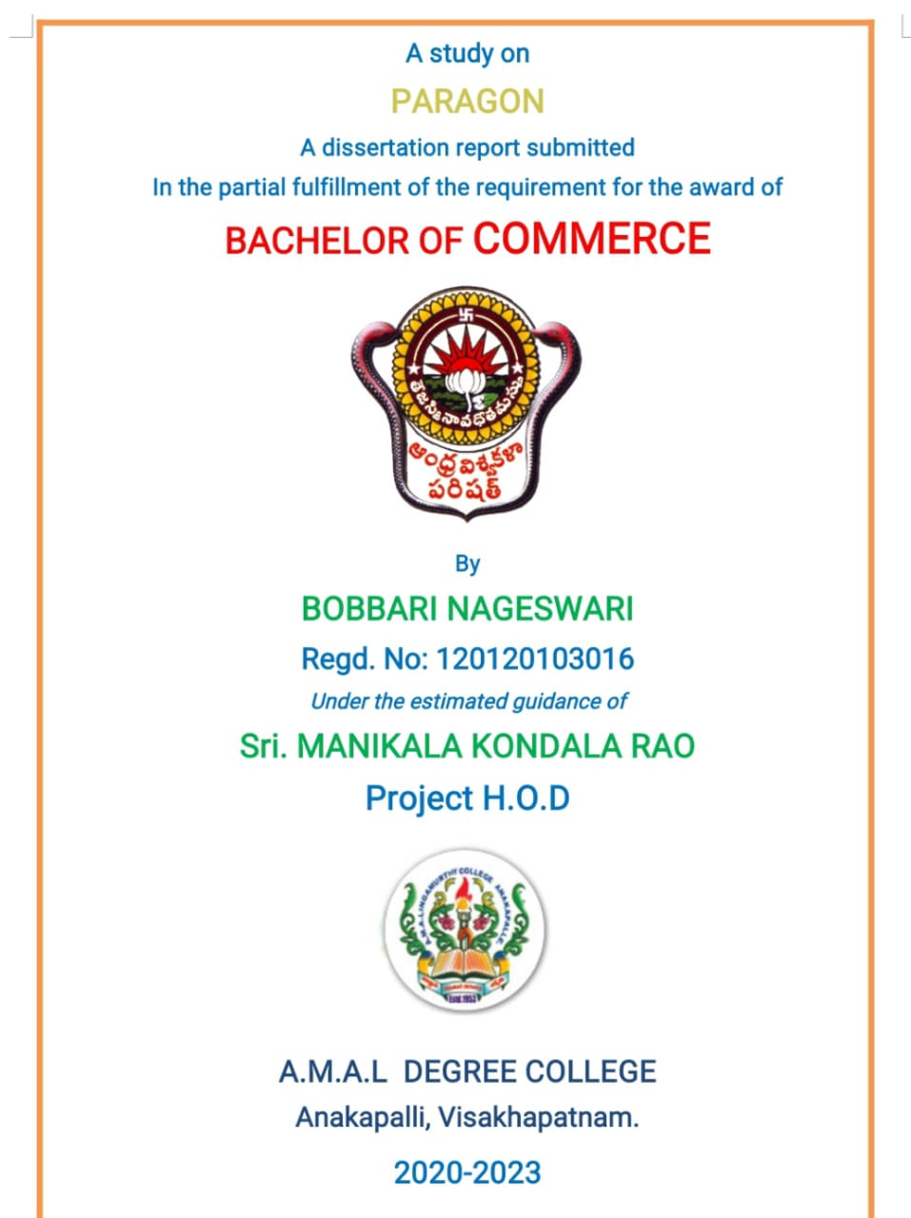

Slide 4
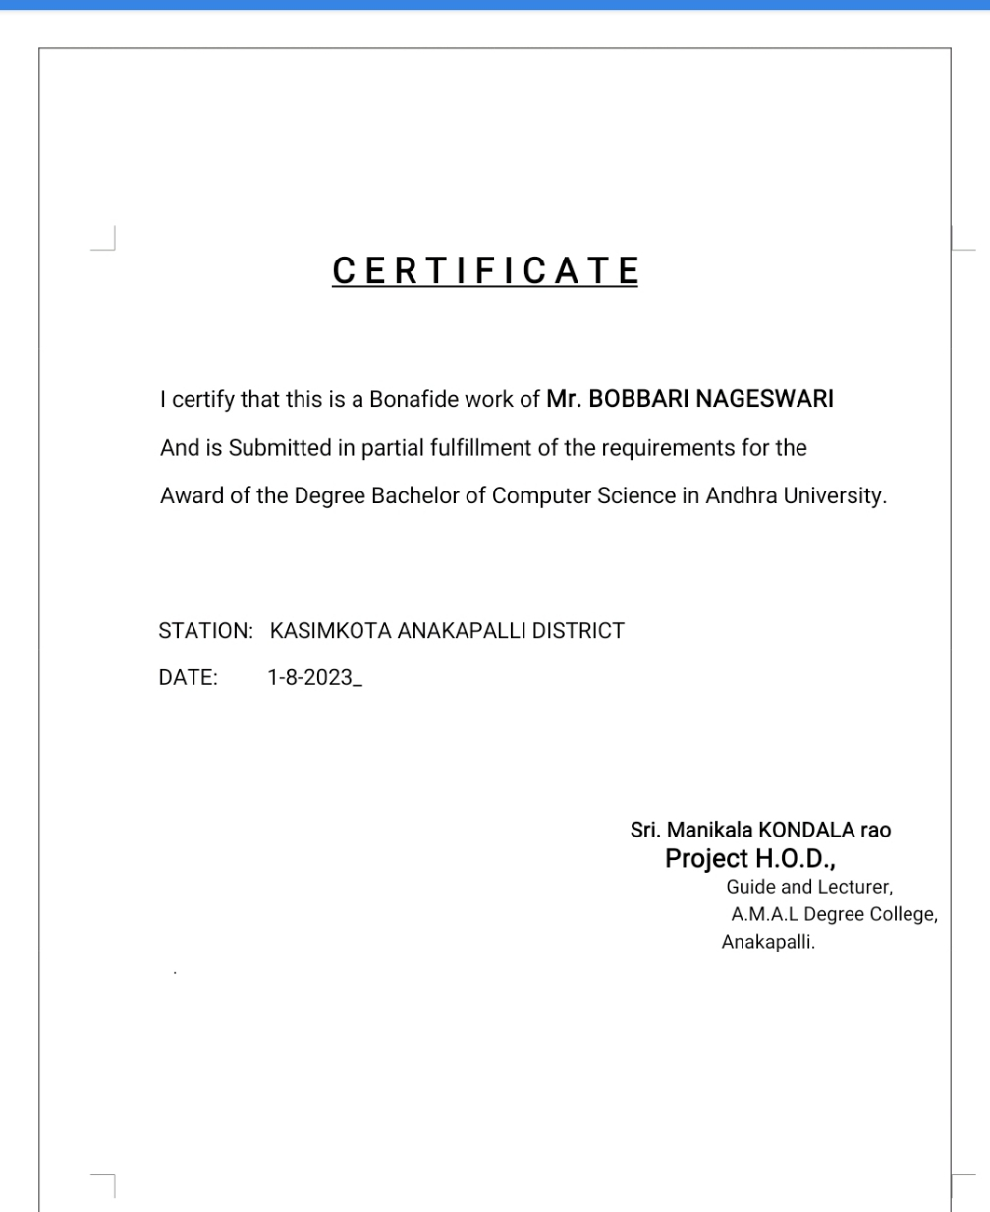

Slide 5
Student's Declaration
I BOBBARI NAGESWARI a student of A. M. A. L COLLEGE Program Reg No. 120120103016
of the Department of COMMERCE COLLEGE do hereby that i have completed. The
mandatory internship from 29-5-2023 to 4-8-2023 In DIGITAL MARKETING ( name of the
intern organization under the faculty guide ship of SMARTBRIDGE , ( name of the faculty guide),
Department of COMMERCE A. M. A. L COLLEGE ANAKAPALLI. (name of the college)
B. NAGESWARI
(Sigunature)

Slide 6
ACKNOWLEDGMENT
I would like to express my sincere thanks to Mr./Mrs.MANIKAL KONDALA RAO
(mentor name), for his/her valuable guidance and support in completing my project I wish to
express my gratitude to the digital Marketing for giving me such a good ideas by granting
permission to do a short term internship. HI would like to express my gratitude towards our
long term internship project coordinator T. NIRANJAN KUMAR For his encouragement and
problem solving during the project. I extend my gratefulness to our correspondent sir MR.
DADI SRINIVAS RAO and Director K. S. N MANGA RAJU sir for their support and heartfelt
completing the project .

Slide 7
I would also like to express my gratitude towards our principal DR. G. JAYABABU for
giving me this great opportunity in do a project on PARAGON SLIPPER. Without their support and
suggestions, this project would not have been completed.
B.NAGESWARI
SIGUNATURE

Slide 8
TEAM MEMBERS
TEAM LEADER : BOBBARI NAGESWARI
TEAM MEMBER 1 : SURISETTI DHANA LAXMI
TEAM MEMBER 2 : SURLA SANYASI NAIDU
TEAM MEMBER 3 : TEKUMUDI CHANDU

Slide 9
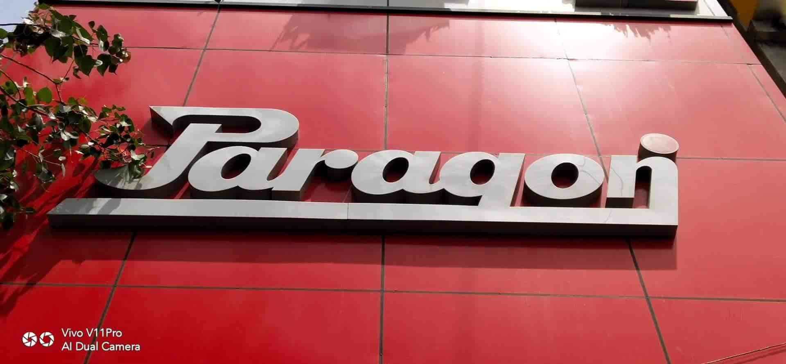

Slide 10
OVERVIEW OF THE ORGANIZATION
SHOEMAKERS SINCE 1975 : was in the year 1975, with a production capacity of 1500 pairs per day, Paragon made its humble entry into its home market in Kerala. In the year 1982, after gaining popularity, Paragon began its passage into other Indian states. The company's distribution network is through 17 depots across India. Retail shops are serviced by more than 500+ distributors, delivering stocks to every corner of the country in the shortest possible time.

Slide 11
The company strongly believes that its greatest strength is its staff and distributors. Catering to millions with the promise of long-lasting footwear, Paragon today is India’s Trusted Footwear Brand in the country. Today, Paragon's total production capacity (in-house) is 400,000 pairs a day. Apart from in-house production, the company out sources production of footwear in Calicut, Delhi and other places. The cumulative production is thus about 14,00,00,000 pairs each year. Paragon’s state-of-the-art ISO 9001:2015 certified factories incorporating the latest in footwear technology are located at:

Slide 12

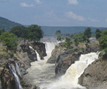
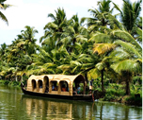
,

Slide 13
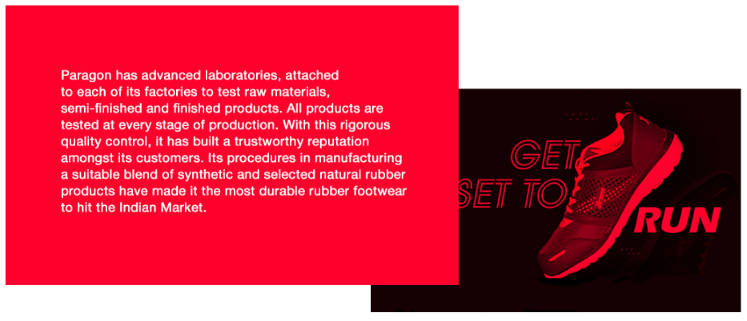
With Paragon assuring durability, availability and quality, the brand has created a wide base of satisfied customers. Not only is the rubber footwear produced by the company bio-degradable, but also the packing material used is made of recycled paper in order to make it more environment-friendly. The PVC, EVA & PU soles are all virgin polymers produced in-house to reduce health hazards.

Slide 14
Part 1: Brand study, Competitor Analysis & Buyer’s/Audience’s Persona
Research Brand Identity: Study the brand's mission, values, vision, and unique selling propositions (USPs).
Introduction to the brand : paragon made its humble entry in the year 1975 with a production capacity of 1500 pairs a day kerala. Retail shopkeeper are served by more then 450 distributers .rubber footwear continues to be its leading product. Footwear are made of poly –urethane (pu) poly viny chloride , ethylene e- vinyl acetate and thermo plastic rubber soles.
Today paragon group total production capacity is 400000 pairs a day. The total sales is approximated to 140000000 pairs each year.
Founder of the company : P.v. Abraham
Founded year : 1975
Official web site : https://www.paragonfootwear.com/

Slide 15

logo : Brand colors : orange, green, red Mission/Values: Our mission is to deliver better business outcomes and become a trusted partner to our clients by providing valuable consulting services. Tagline :'Paragon Pehen Ke Chalo' USP: With Paragon assuring durability, availability and quality, the brand has created a wide base of satisfied customers. Not only is the rubber footwear produce Company / topic for pr Company / topic for project : paragon brand messaging : Footwear brand Paragon has launched a new campaign.

Slide 16
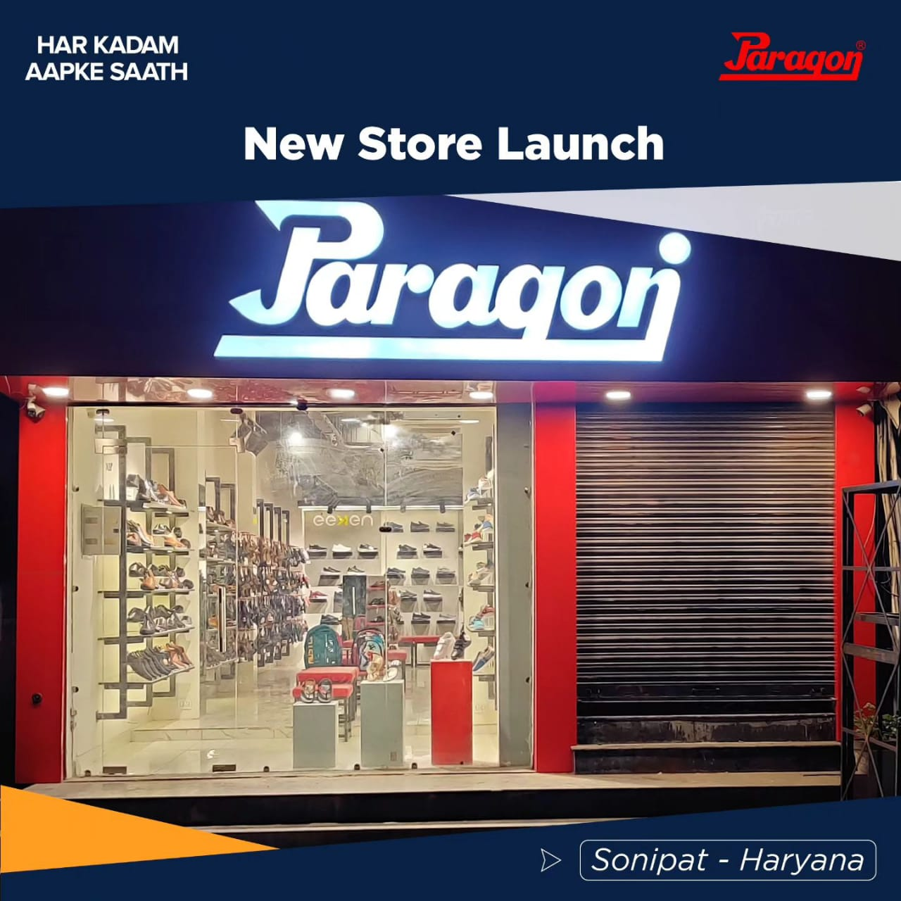
. Explain :A paragon means someone or something that is the very best. The English noun paragon comes from the Italian word paragone, which is a touchstone, a black stone that is used to tell the quality of gold. You rub the gold on the touchstone and you can find out how good the gold is. The Paragon Group of companies is No. 1 in the organized rubber footwear sector. Its procedures in manufacturing a suitable blend of synthetic and selected natural rubber products have made it the most durable rubber footwear to hit the Indian Market.
https://www.instagram.com/reel/CuHJiehhosh/?igshid=MzRlODBiNWFlZA==

Slide 17
Part 1: Brand study, Competitor Analysis & Buyer’s/Audience’s Persona
Analyse Brand Messaging:
How to Create a Brand Messaging Framework | Sprout Social
Brand messaging is how you communicate your company's value proposition, personality and competitive differentiators across different channels. Several factors go into a holistic brand messaging strategy. It's not just about what you say. It also includes how you say it and who you say it to
Examine the brand’s tagline : A tagline is a short phrase or slogan that encapsulates that brand’s essence and differentiation. The slogan of the Paragon brand chapel is "Wear Paragon, Walk with Style and Comfort." Continue reading.

Slide 18
Part 1: Brand study, Competitor Analysis & Buyer’s/Audience’s Persona
Competitor Analysis: Select three competitors operating in the same industry or niche as the chosen brand, examine their USPs and online communication.
Competitor 1:https://www.mafshoes.com/
Usp : With every pair you purchase, TOMS will give a pair of new shoes to a child in need. One for One.”
Communication :Maf Shoes appears on linkedin, facebook. Reach your target audience. An email address is your first line of communication with a customer.
Competitor 2 :https://www.aniger.com.br/
Usp :the one thing that makes your business better than the competition.

Slide 19
Communication : Generate a content, show the videos, digital screen plate, t. V communication.
Competitor 3: https://www.dsi.lk/
Usp : manufacturing and marketing of types and allied products in respect of the highest level of design, quality, assurance, safety, innovation, customer interaction and business ethics.
Communication: DSI Communications Ltd is a private company. The company currently specializes in the Information Technology and Services area.

Slide 20
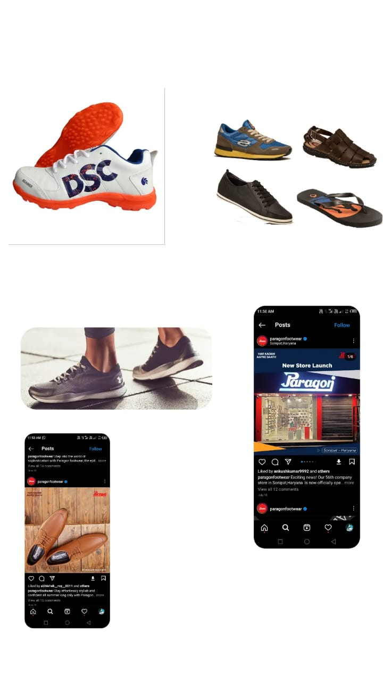
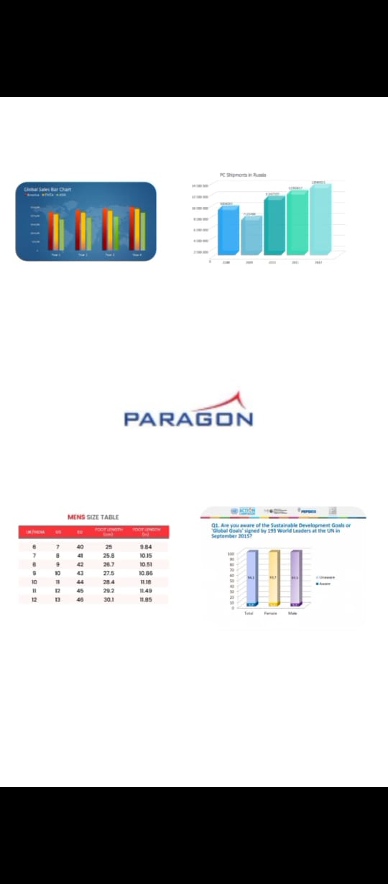

Slide 21
Part 1: Brand study, Competitor Analysis & Buyer’s/Audience’s Persona
Buyer's/Audience's Persona: Clearly define the target audience for the chosen brand. Consider demographics, psychographics, behaviours and interests.
Clear definition of the paragon brand : A target audience is a group of consumers characterized by behavior and specific demographics, such as female extreme athletes between the ages of 18 and 25. Target audiences are a pillar of most businesses influencing decision-making for marketing strategy.
Demographic and psychographic : Demographic factors are characteristics of the target audience that can be measure by objective, includes, age, gender, income, education levels, occupation, demographic factors help in segmenting the target audience.
Psychotropic factors are characteristics of the target audience that connect be mesurd objective these includes values belief attitude, intrest and it can complete picture of the target audience

Slide 22
Audience behavior and interest: the help in understanding the target audience behavior patron's preference and main points and how they make purchasing decisions and others factors that influence their behavior Interest includes hobbies, activities etc. Understanding the target audience interest can help in creating message that resonate with them

Slide 23
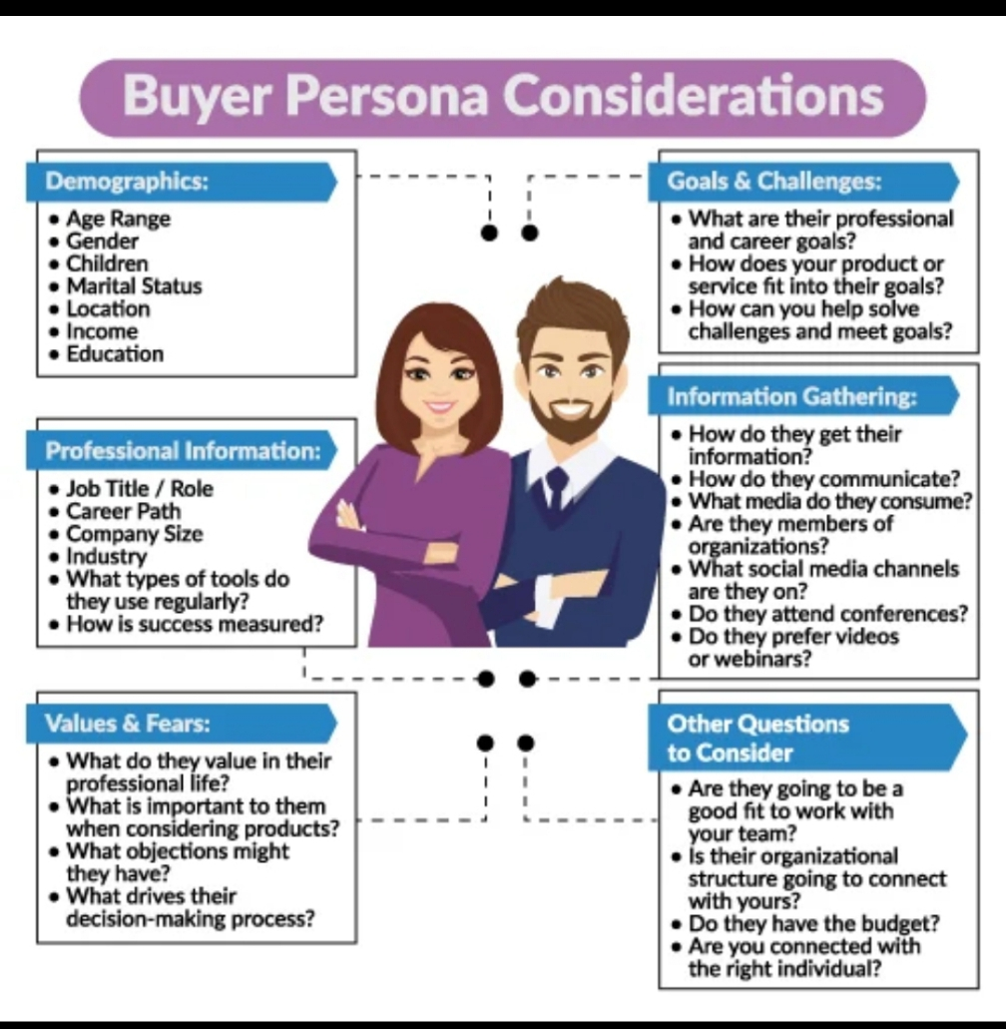
paragon.
Boy and girls
Age : 3-50 years
Paragon have almost
Branches all over of
India .
Ads: YouTube,
Instagram
Community platform
Like Google .
Social status : persona experience
Long lasting price.

Slide 24
Part 2: SEO & Keyword Research
SEO Audit: Do an SEO audit of the brands website
Keyword Research: Define Research Objectives, Brainstorm Seed Keywords, Utilize Keyword Research Tools (SEMrush or Moz Keyword Explorer),Analyze Competitor Keywords, Long-tail Keyword Exploration (specific, longer phrases) that align with the research objectives and have lower competition but higher conversion potential.
On page Optimization: Meta Tag optimization & content optimization
Reflect on the process of conducting keyword research and the SEO recommendations provided.
Document the challenges faced during the research and analysis phase, as well as the key insights gained from the keyword research process.

Slide 25
SEO :
search engine optimization is the process of increase the traffic of visitors to the website from search engines via organic means using different algorithms via natural are un-paid ways
Most popular seo platform are Google and yahoo search engines. People perform various strategies to appear on the front pages of theses search engines which are widely used by customers all over the world.
typically, the earlier (or higher) a site appears in the search results list, the more visitors it will receive from the search engine.
This gives a web site web presence.
PPC (aka search engine advertising) :
Pay per click ( ppc ) is an interest advertising modal use on web sites for advertisement, in which advertisers pay their ad is clicked.
With search engines like Google and yahoo, advertisers typically bid on keyword phrases relevant their target market.

Slide 26
Keyword research : ` Keywords are the words that describe your topic of research. These can be individual words or a phrase. These keywords can be chosen from the sentence you create to define your research topic. Once you choose the significant words, you can then come up with synonyms, or words with similar meanings.
These keyword types include: short tail, long-tail keywords, short-term (fresh), long-term (evergreen), product defining, customer defining, geo-targeting, LSI (Latent Semantic Indexing), and intent targeting.12-Feb-2019
seed keywords : Begin with seed keywords that directly relate to the product, such as” paragon slippers” footwear”, “or” paragon slip- on shoes”.
Intent- based keywords :Target keywords based on user intent, like” best paragon slippers,” “affordable paragon slippers,” or” paragon slippers reviews.”
LONG-TAIL KEYWORDS : Incorporate longer an more specific phrases that reflect the user’s search queries, like “ slip- on paragon slippers with arch support” or “ best – selling paragon slippers for seniors.”

Slide 27
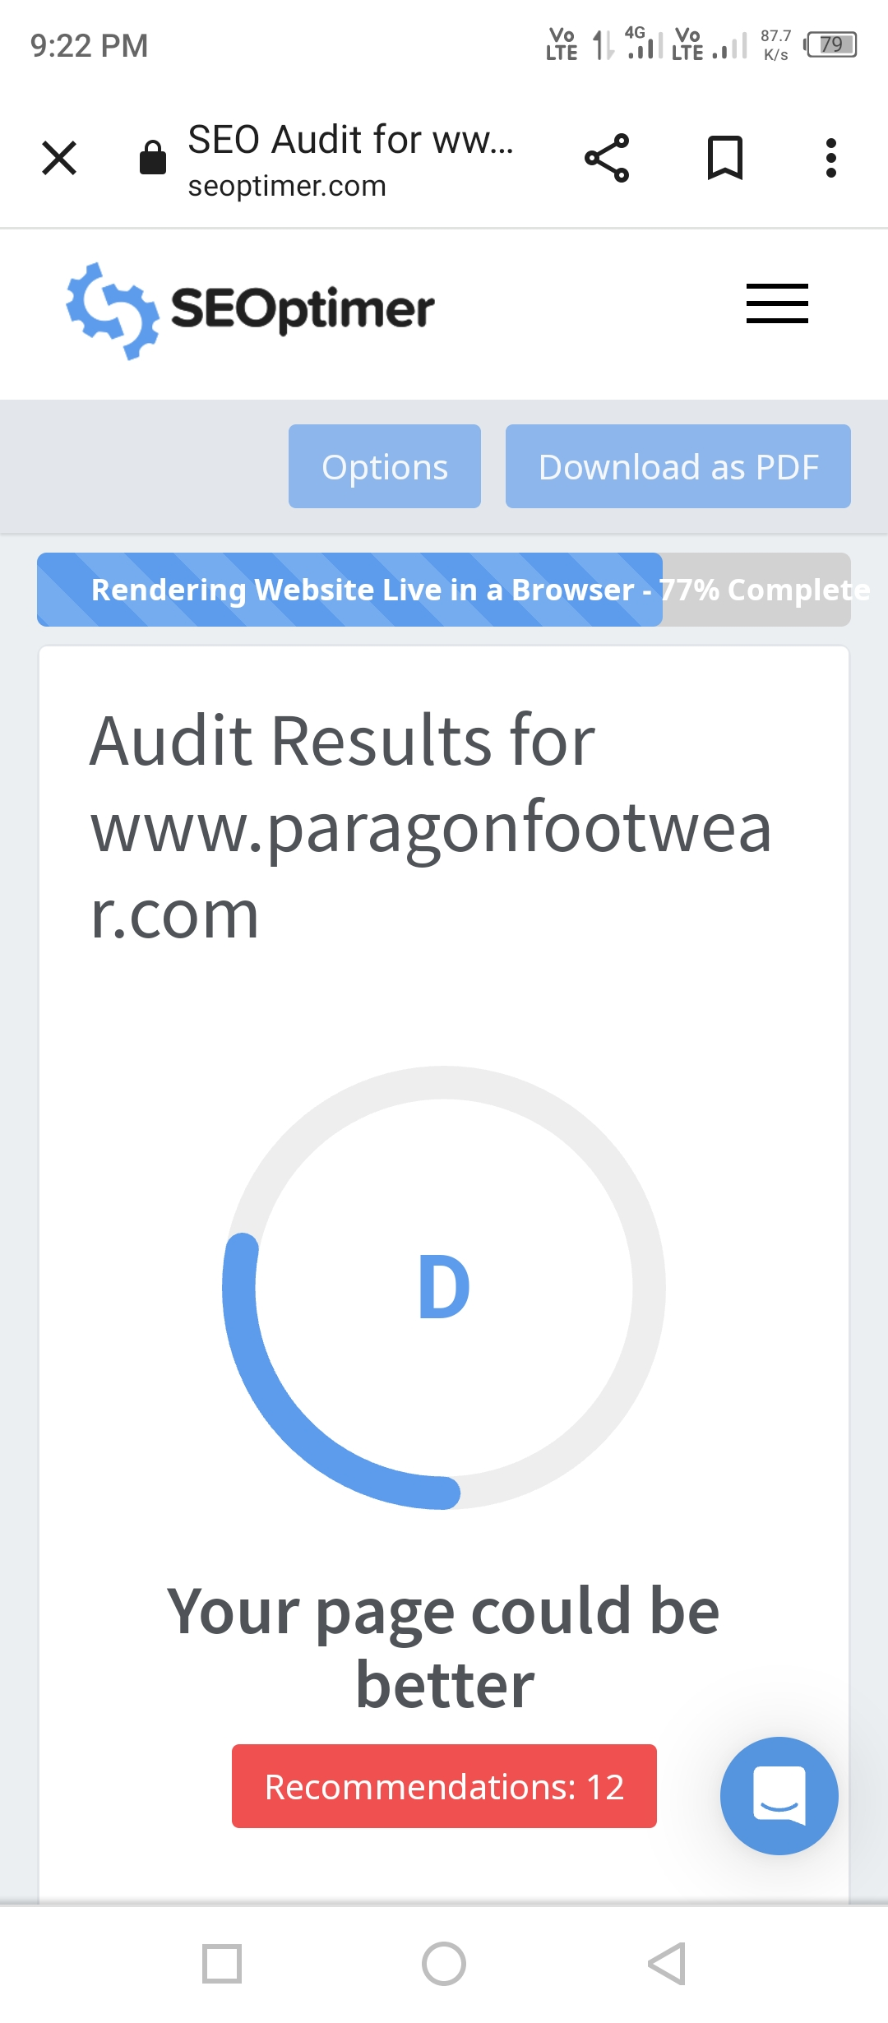
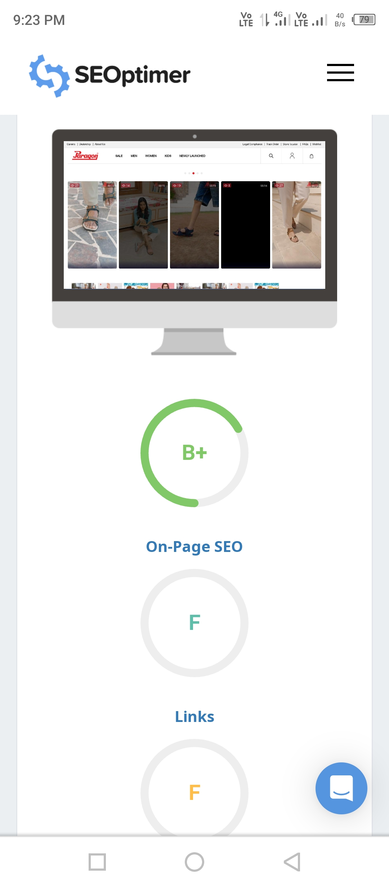
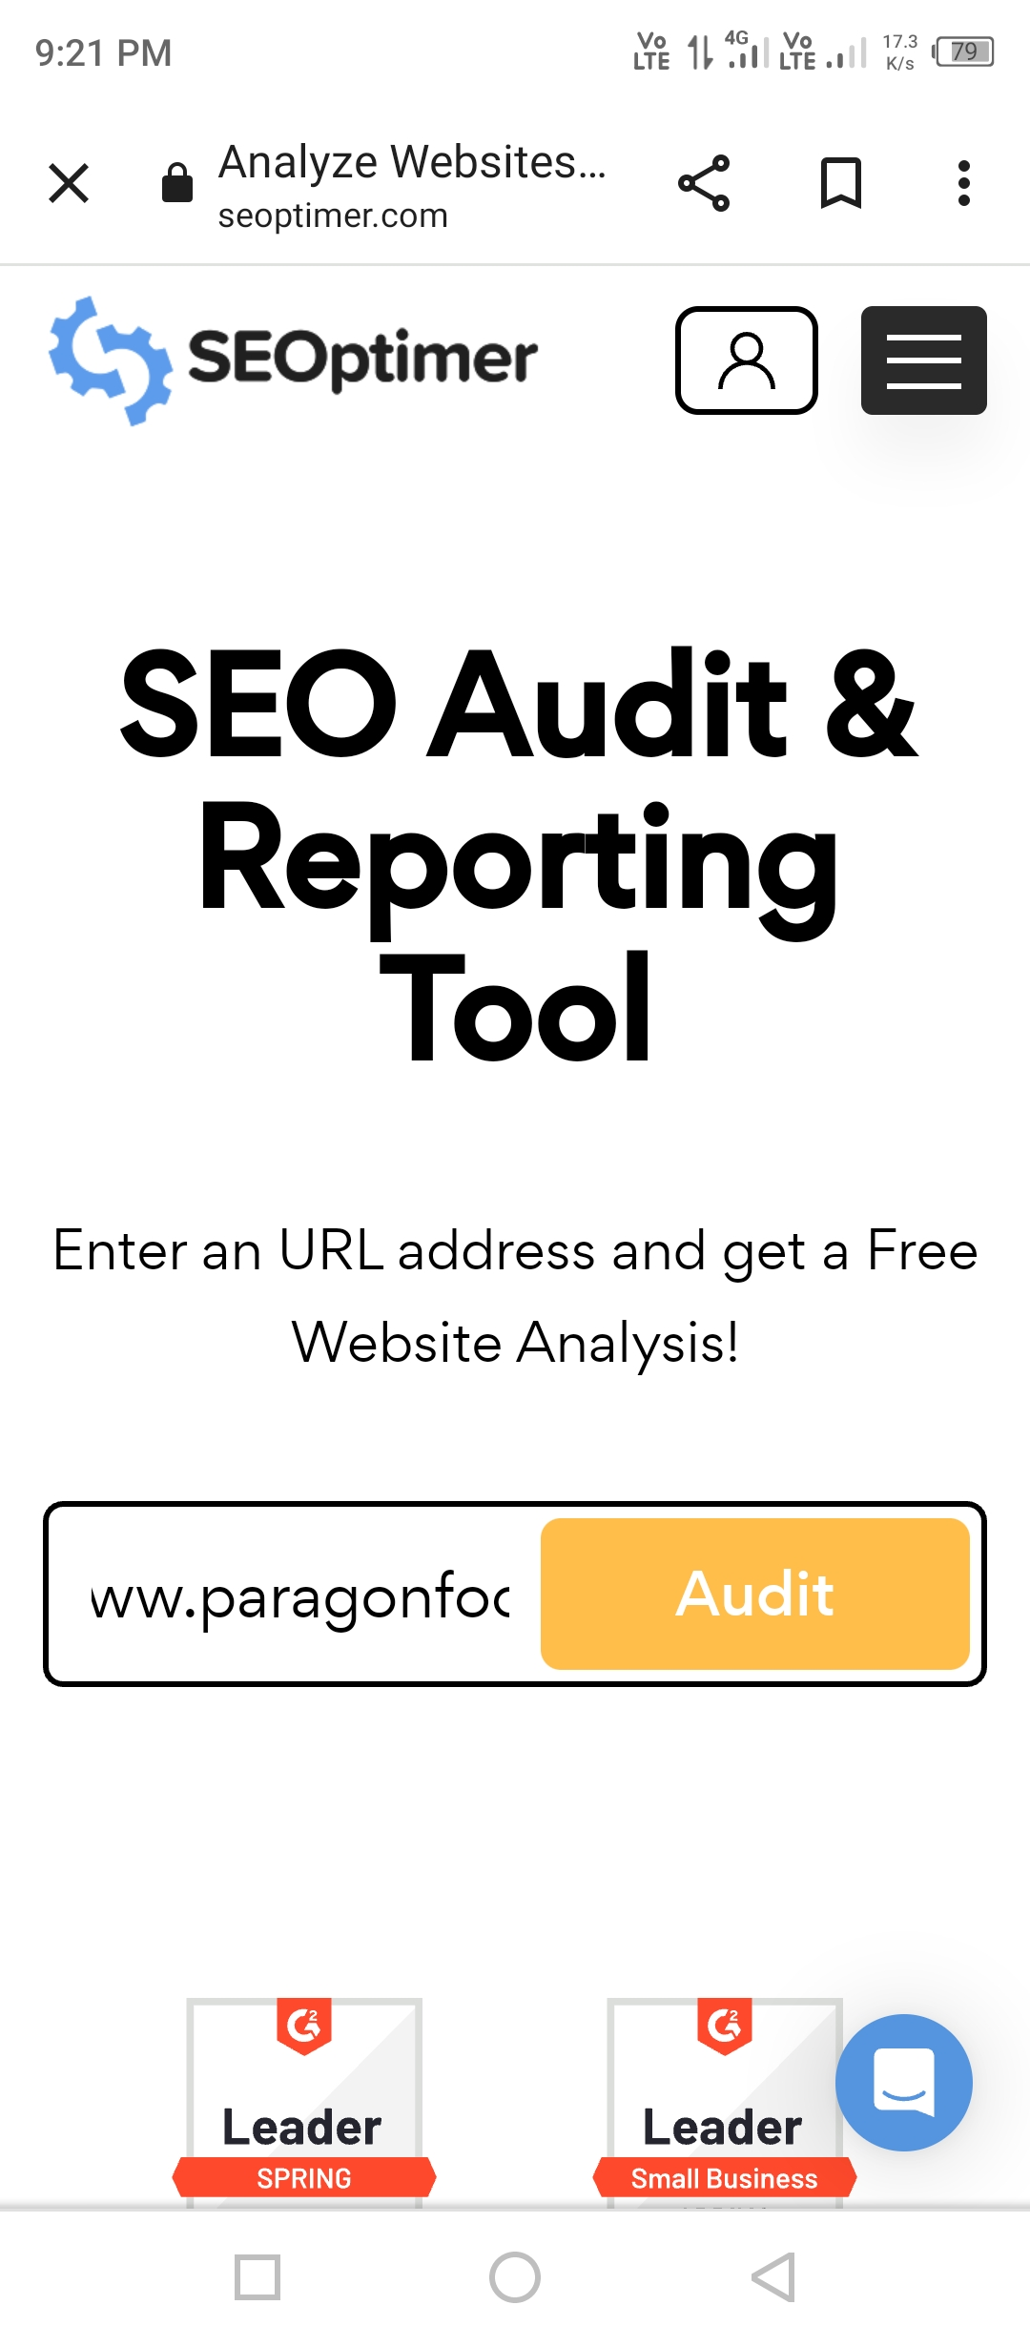

Slide 28
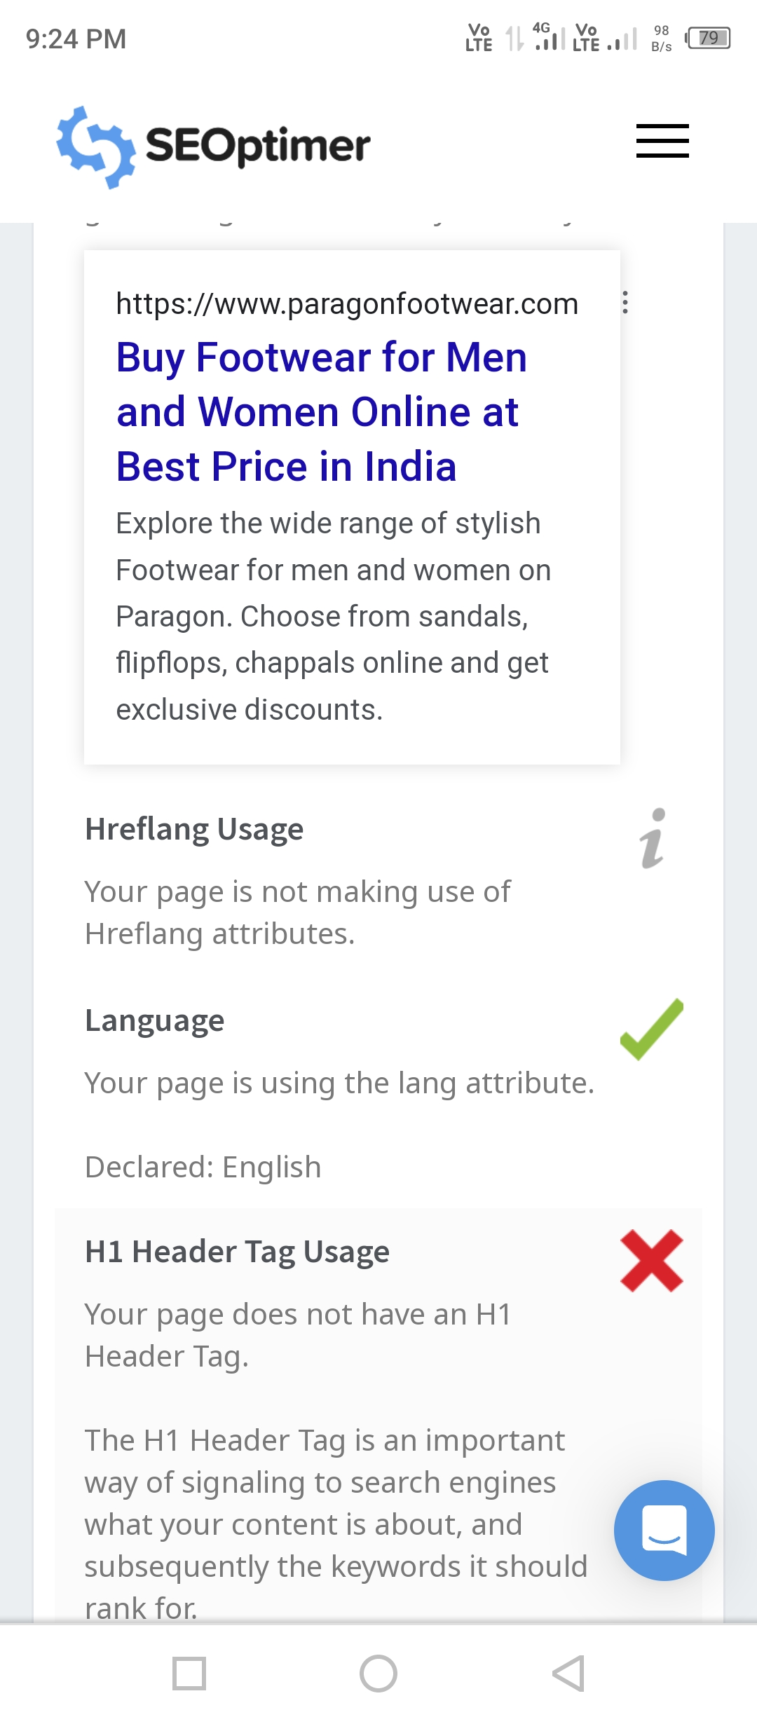
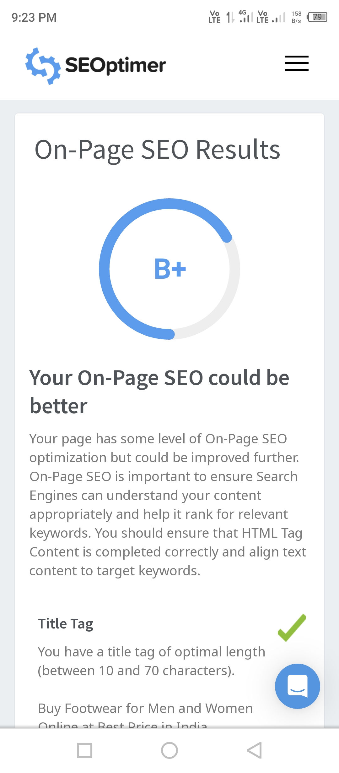
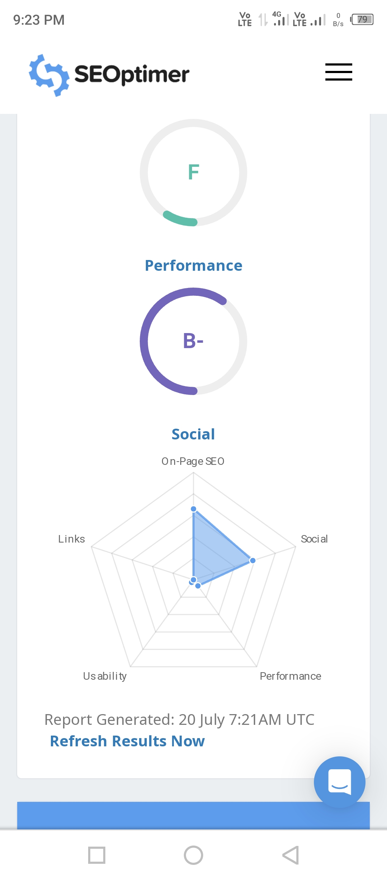

Slide 29
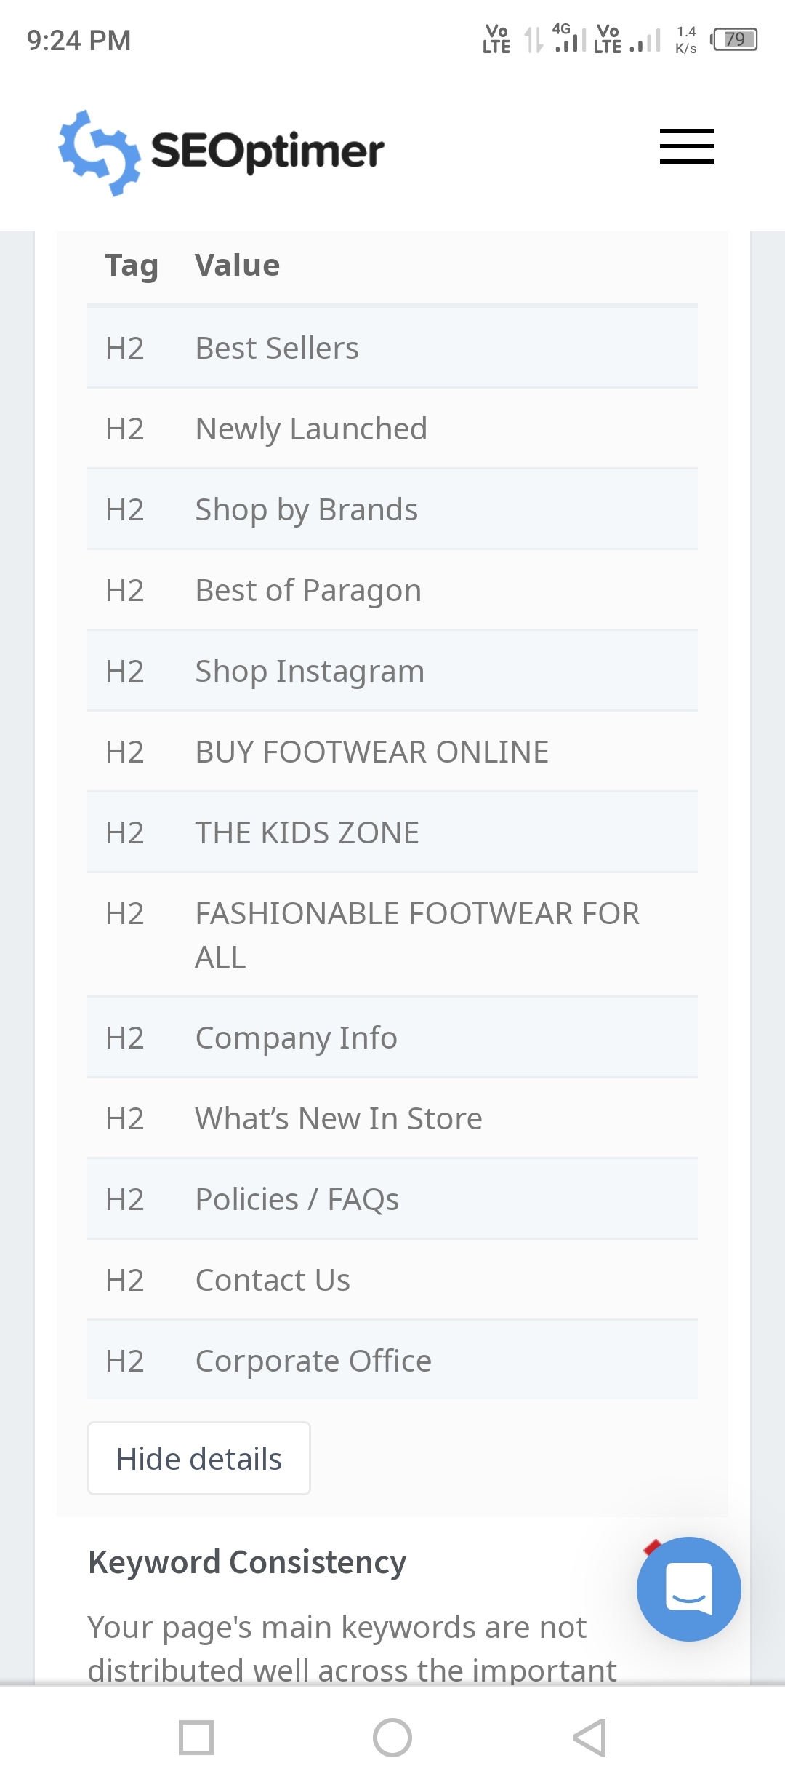
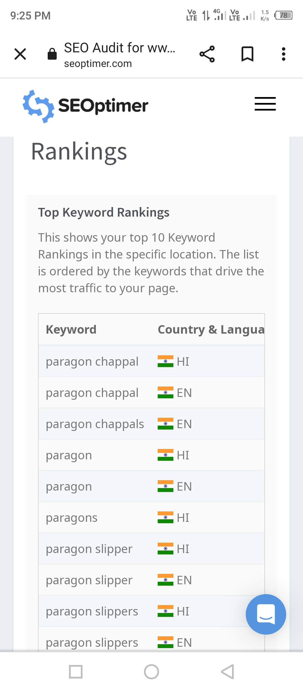
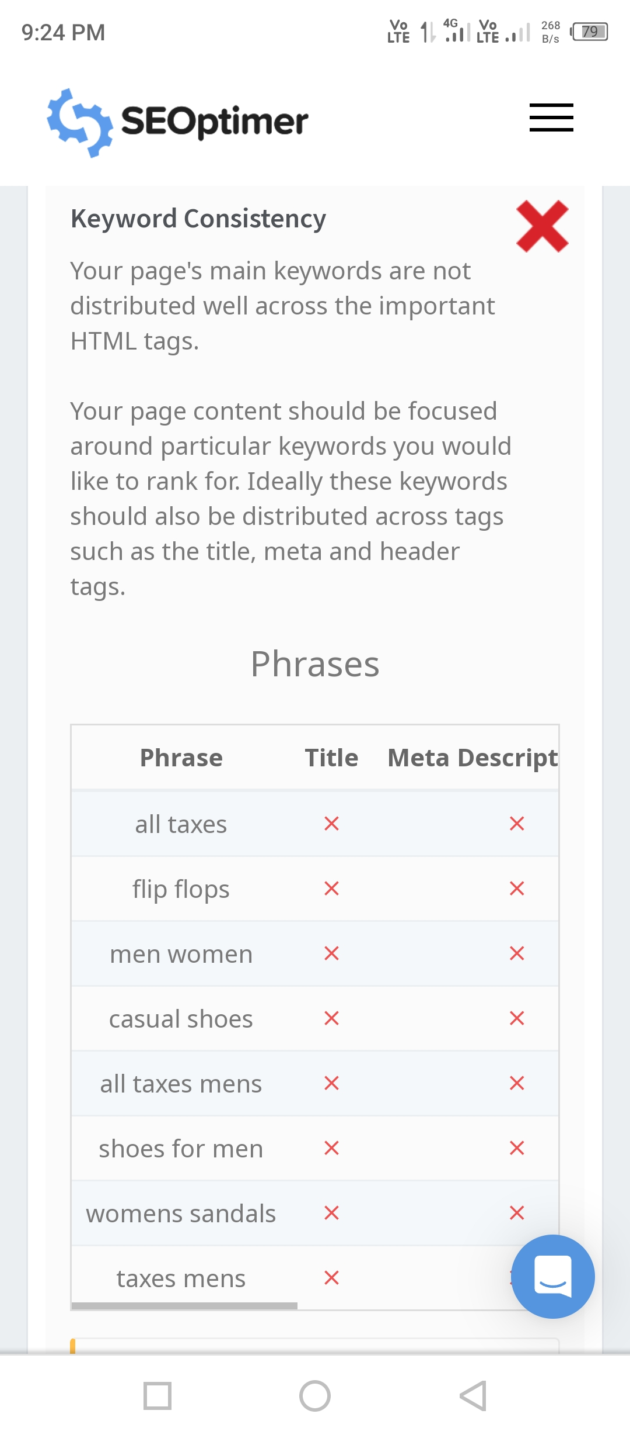
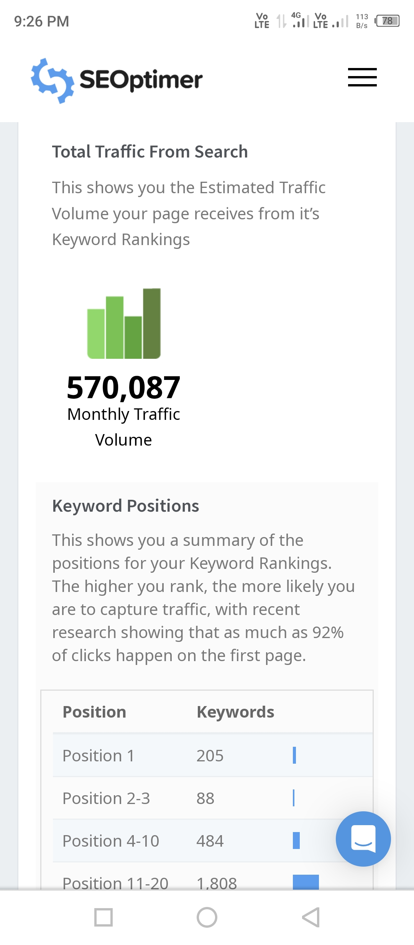

Slide 30
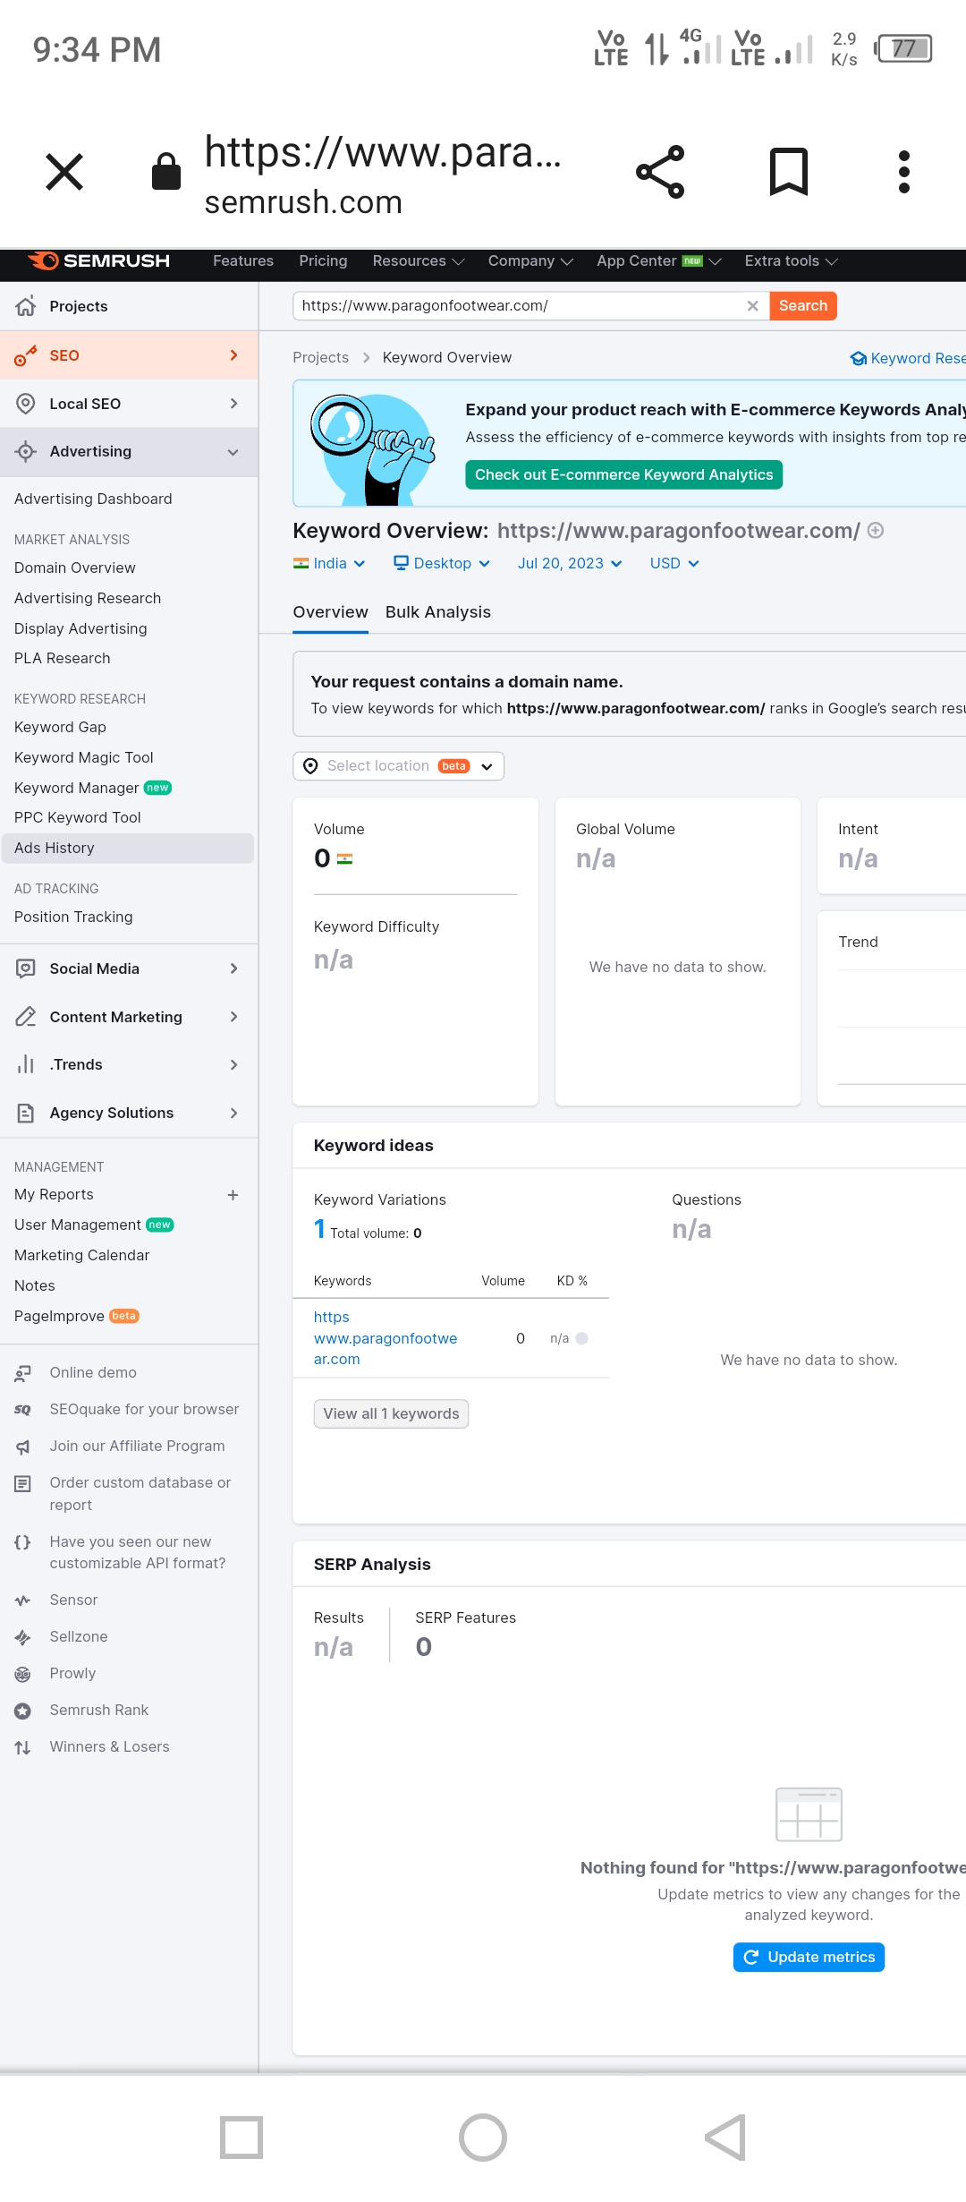
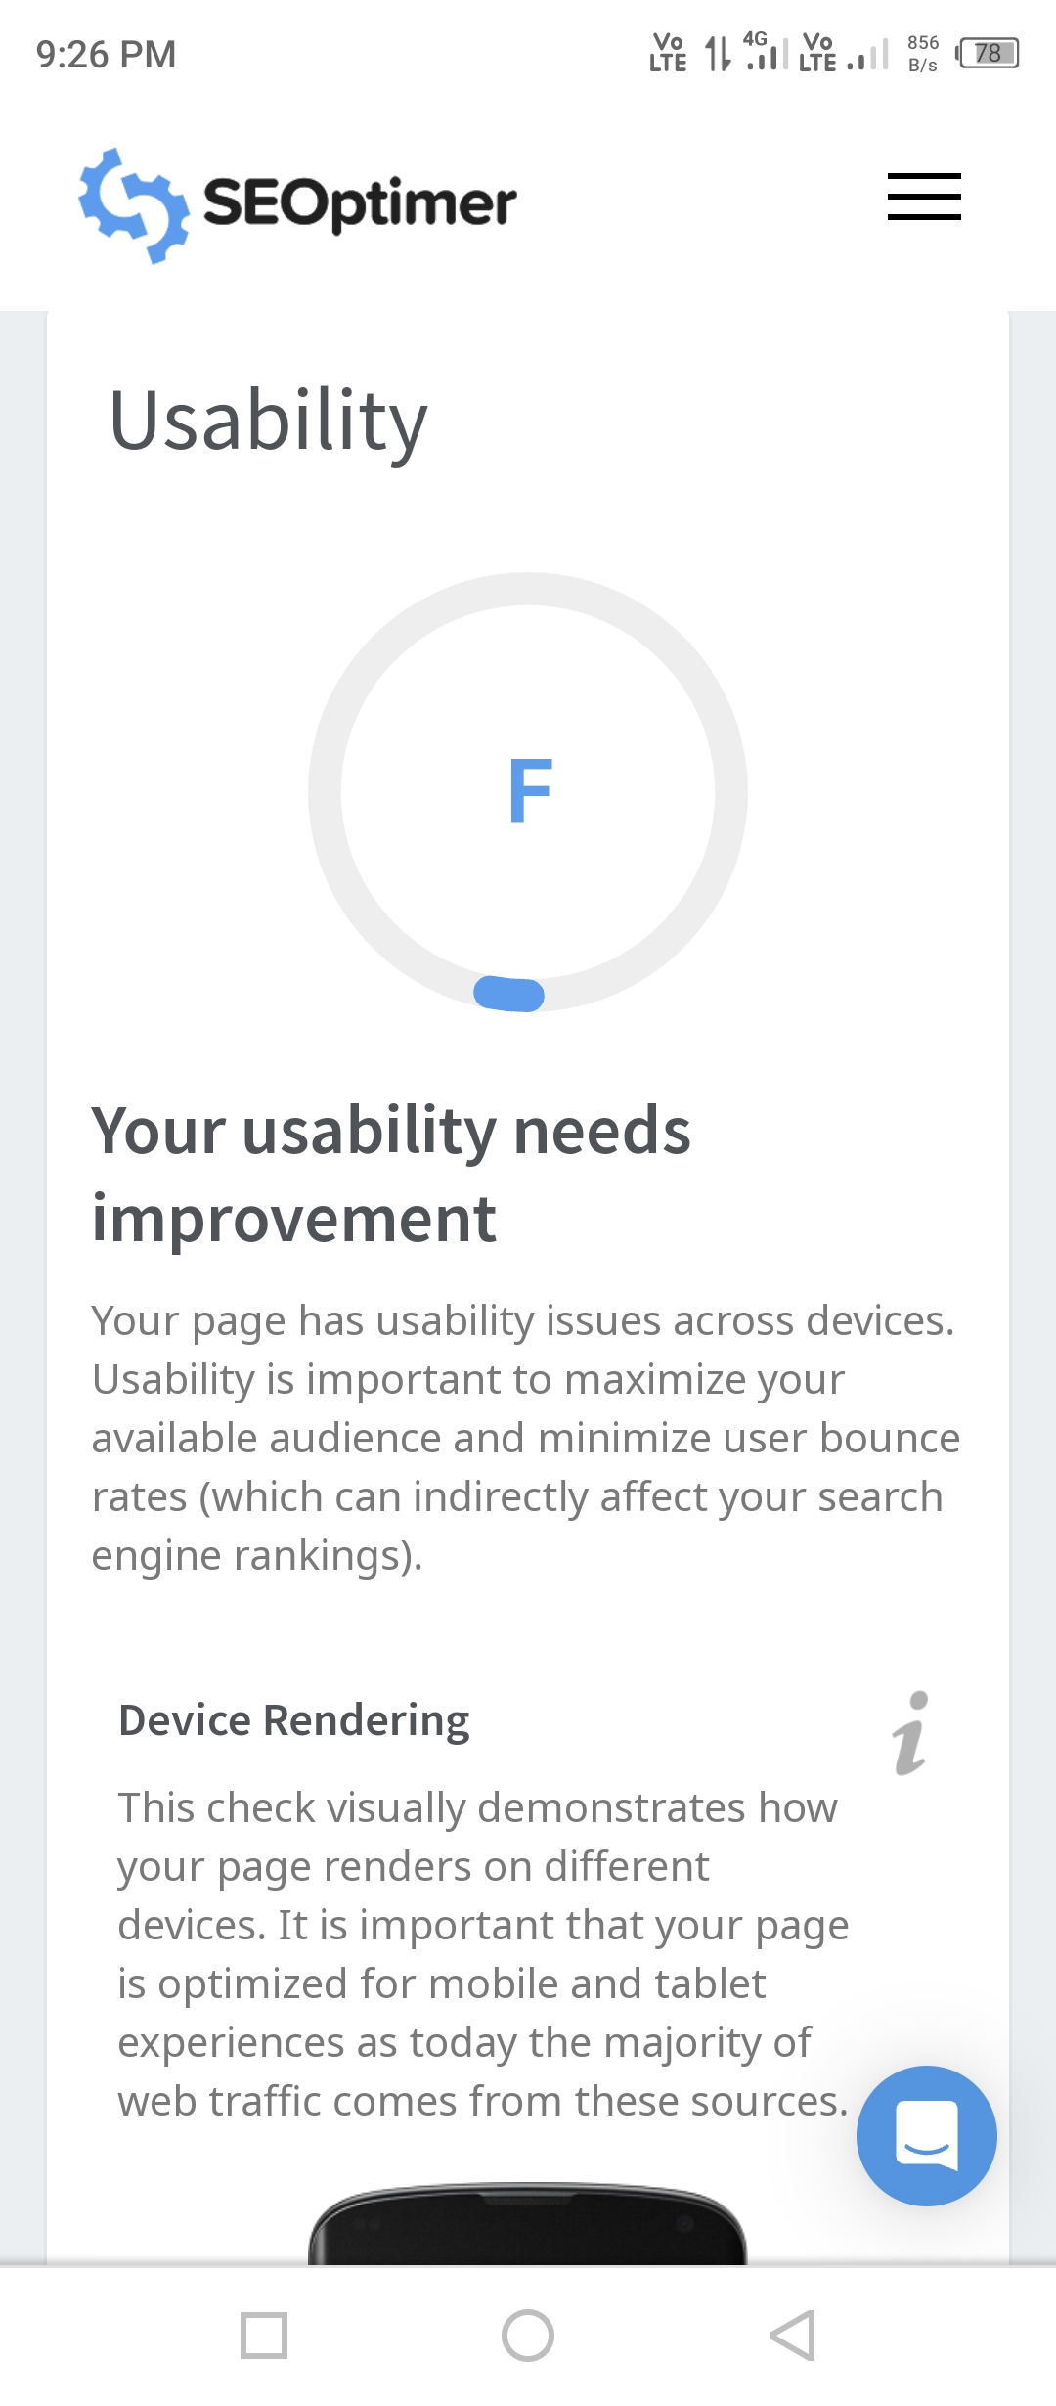
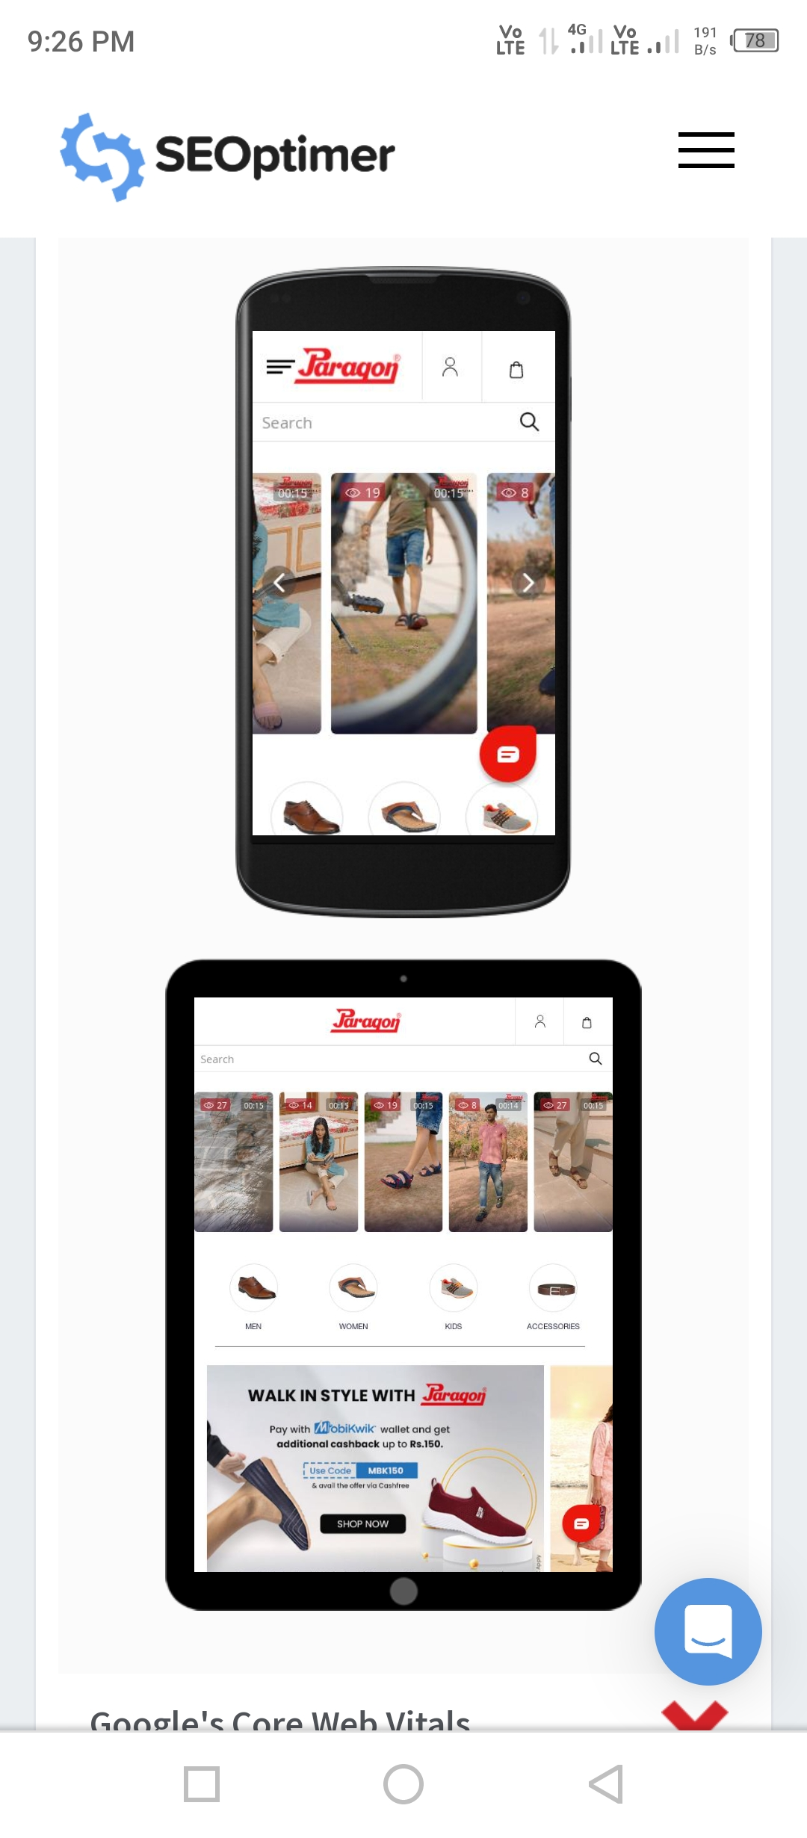
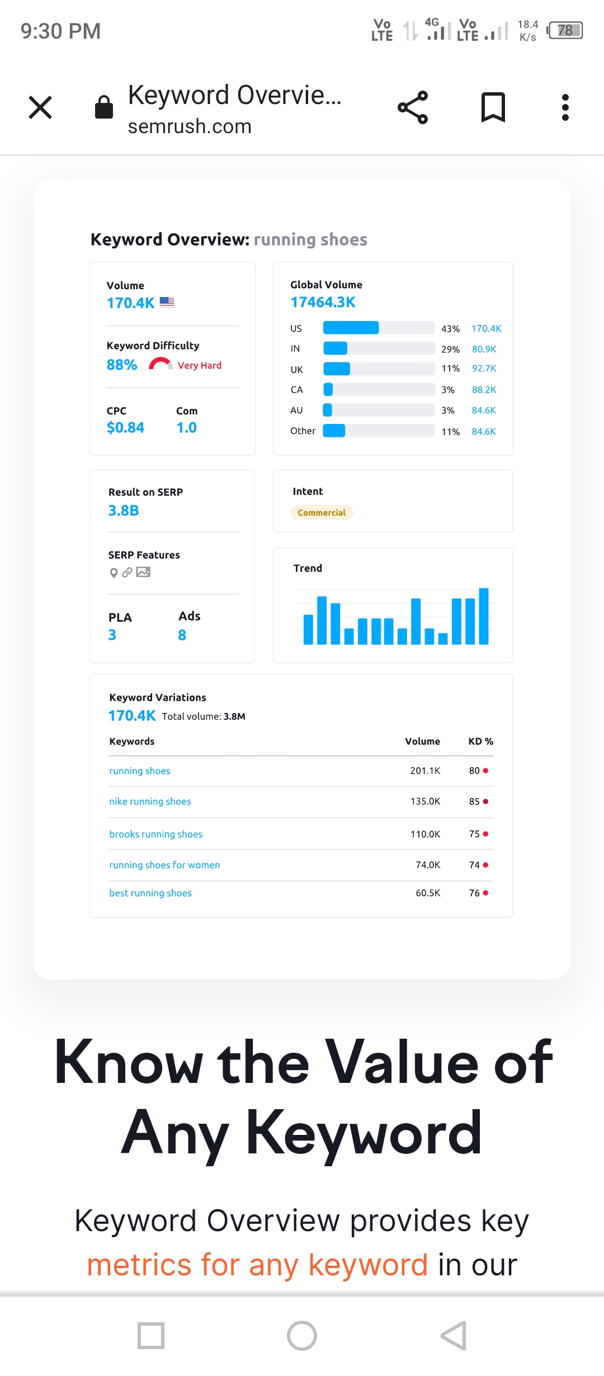

Slide 31
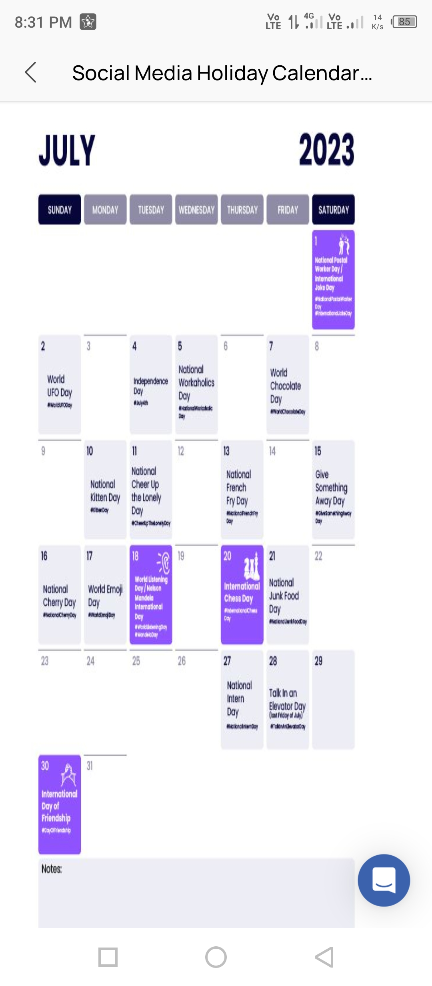
Part 3: Content Ideas and Marketing Strategies
Content Idea Generation & Strategy: Create a content calendar for the remaining month of July by brainstorming content themes, exploring various formats like blog posts, videos, info graphics, podcasts, and interactive quizzes, and scheduling publication dates mainly on Facebook & Instagram. And include the strategy, aim and the idea behind these posts and story
Content Calendar Example (Try creating a table for the month of July)

Slide 32
Part 3: Content Ideas and Marketing Strategies
Repurpose Your Existing Content.
Make An Expert Roundup.
Craft Some Holiday Content.
Start A Podcast.
Create Actionable Content That Gives Instructions About How To Use Your Product.
Create Content On The Best Practices For Your Industry.
Write Guides That Break Down Different Topics In Your Industry.
Write A Case Study.
Marketing strategy process: The strategic marketing process involves conducting research and establishing goals and objectives that will maximize the effectiveness and success of your overall marketing strategy. This process is beneficial as it helps you be more intentional with your marketing.

Slide 33
Recruiting talent : What does a recruitment marketing strategist do?
Recruitment Marketing Specialist is a human resources professional who develops company's Employer Branding and Recruitment Marketing strategies by bringing modern marketing methods and tactics to the recruiting process in order to attract top talent in the market.
Maintaining a sufficient budget: a planning or decision-making tactic appropriate for an organesation when growth opportunities are low but the firm is in a relatively strong position in the market; a maintenance strategy implies that the firm will continue to invest in the business, in a limited way, to maintain the current volume of business.
Generating leads.: Lead generation is the process of attracting people (leads) to your business and converting them into customers Lead generation is a process that's usually implemented via marketing campaigns supported by marketing automation, and It offers an exciting approach to digital marketing because it reverses the typical ...
Finding the right tools. : Marketing tools are techniques, resources and digital programs that help companies promote their products and services effectively. These tools also help advertisers implement marketing campaigns and track their progress afterward.

Slide 34
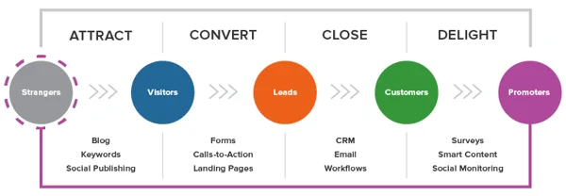
marketing strategy's for process : The steps of the strategic marketing process (mission, situation analysis, marketing plan, marketing mix, and implementation and control) are different than the process for a specific marketing effort
Lesson from the marketing : What can you learn from marketing strategy?
Brand equity refers to the value which a brand improves on a product or service beyond its functional benefits. In a marketing strategy course, students can learn about the various aspects of brand equity, including brand awareness, brand loyalty, and brand associations

Slide 35
Part 4: Content Creation and Curation (Post creations, Designs/Video Editing, Ad Campaigns over Social Media and Email Ideation and Creation)
Post Creation:
Select Content Categories: Identify three different content formats relevant to the chosen topic or industry. Research and Brainstorm: Research trending topics, industry news, or audience interests within each category. Brainstorm ideas for social media posts that align with each category. Do note that 1 content format has to be video and additionally 3 stories/status are to be created.
Format 1: blog article
Aim : boost seo & provide information about a certain new product of paragon slippers
Date : June 07, 2022.
Ideas: paragon has launched new water proof chapels' and shoes and this blog will cover the details about them by outstanding products
.
Topic : 3 ways you can wear waterproof slippers and shoes.

Slide 36
Format 2 : VIDEO
AIM : he company has set a target of increasing its store count to 150 by the end of this financial year. Over the next 3 months, Paragon aims to ...
Date : 23-7-2023
Idea : Pick footwear that has some kind of fastening - like velcro, ankle straps, or laces. In the case, you prefer shoes without laces, snug fit shoes
Topic : SHOEMAKERS SINCE 1975 ... As a brand that sells all over the country, Paragon needs little or no introduction in the Indian sub-continent. While rubber footwear ...
Missing
Format 3 :
Aim : brand awareness & reach
Date : 29-Jan-2023
Idea: A complete multimedia workshop! A company of a growing team of freelancers, artists and digital media
Topic : . perfect or have a lot of a good quality. Paragon

Slide 37
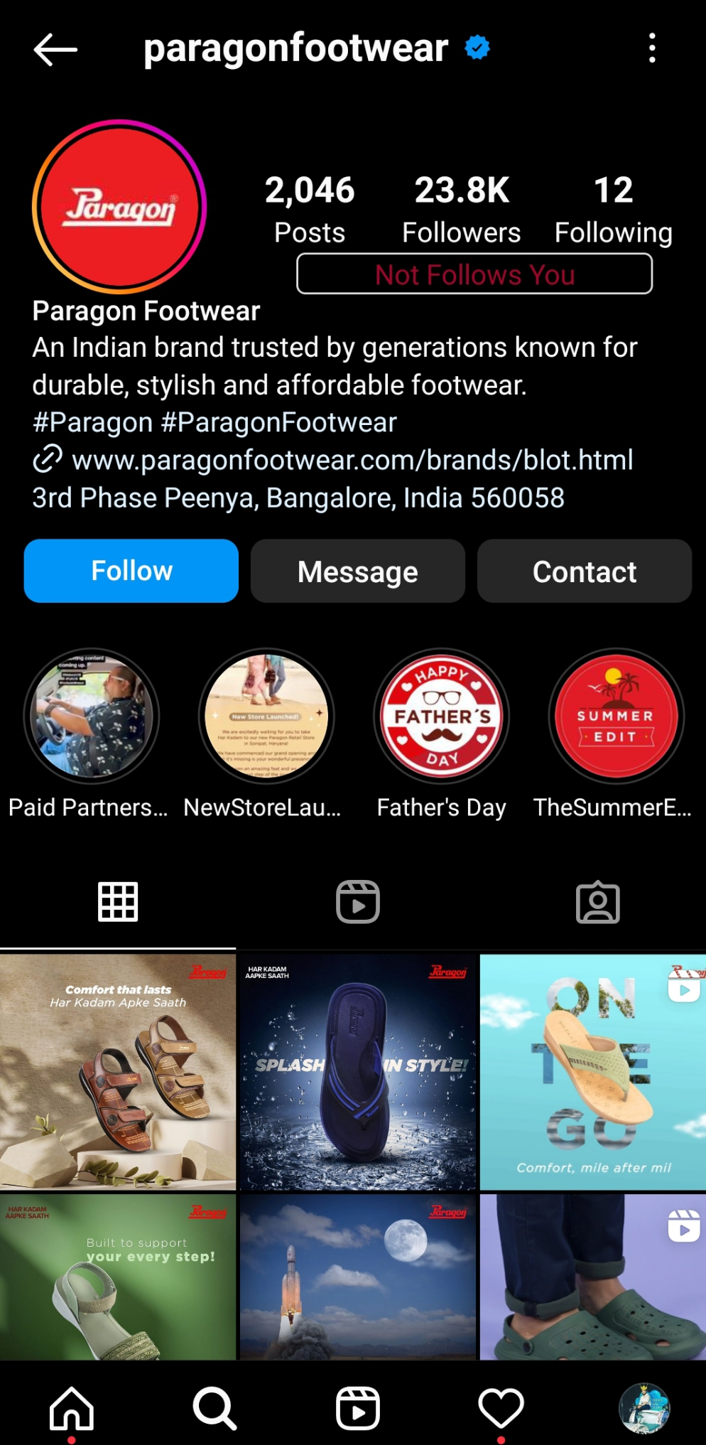
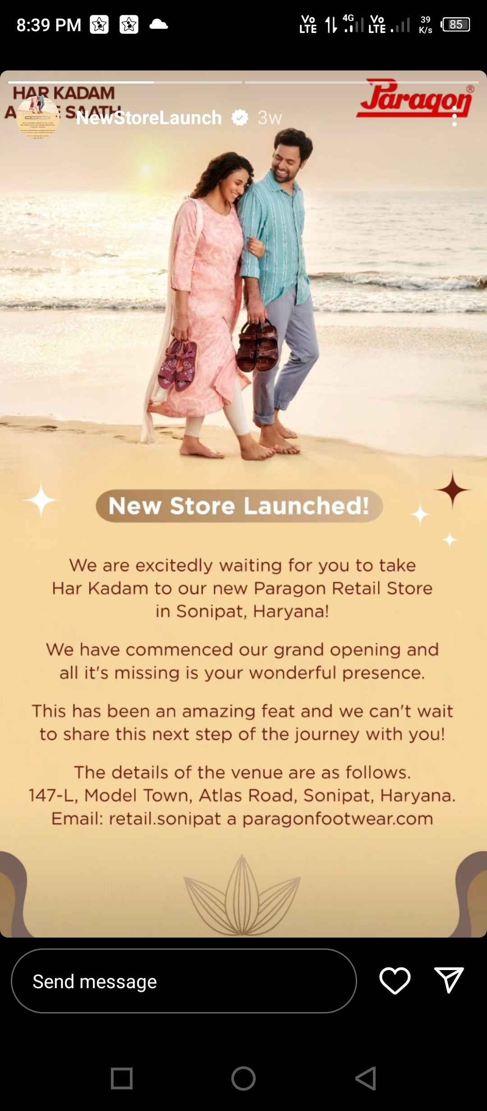
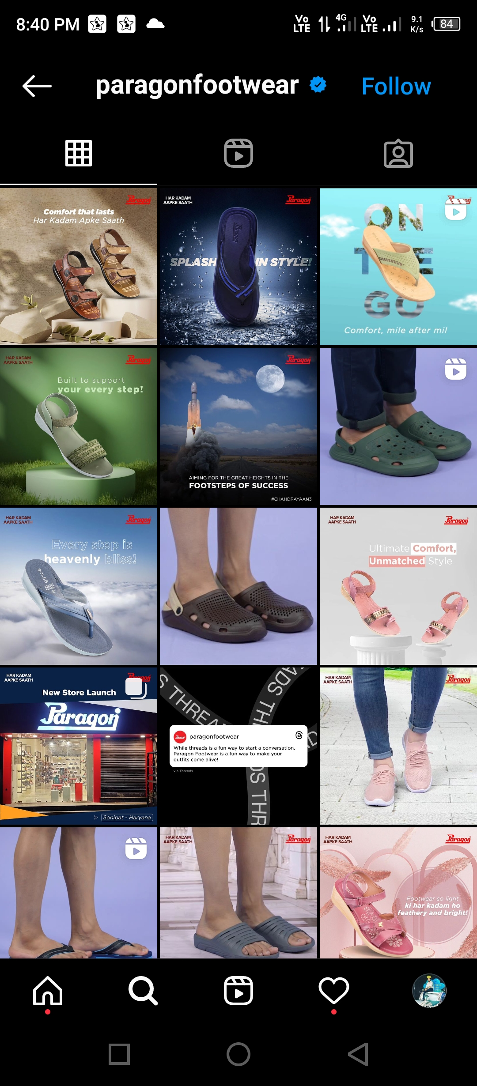
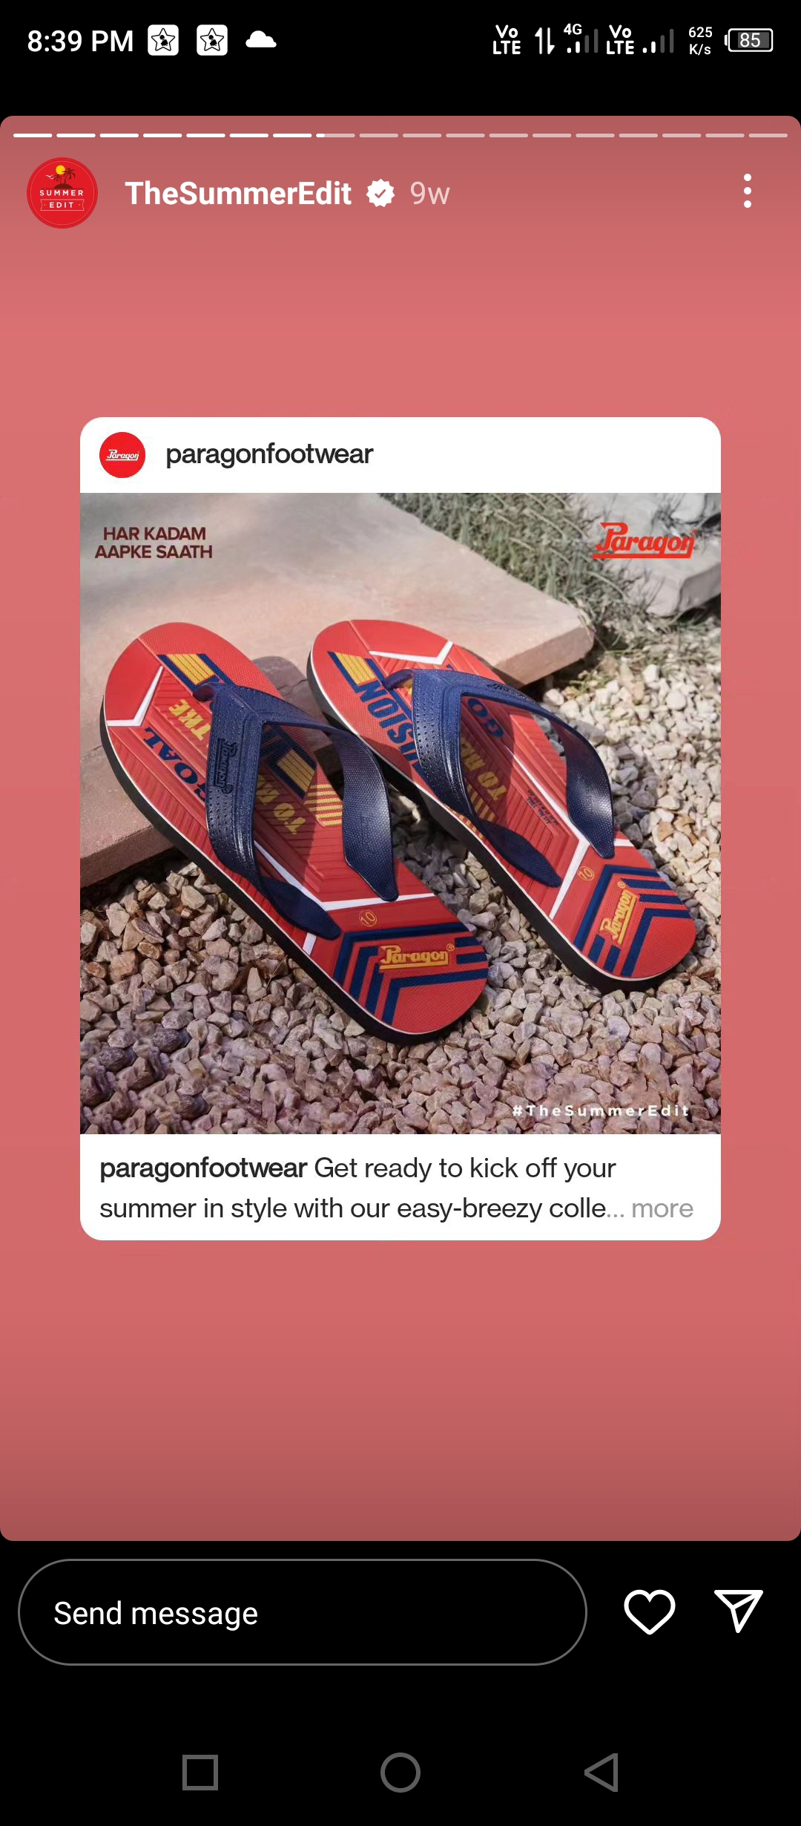
Part 4: Content Creation and Curation (Post creations, Designs/Video Editing, Ad Campaigns over Social Media and Email Ideation and Creation)
Instagram Story

Slide 38
Part 4: Content Creation and Curation (Post creations, Designs/Video Editing, Ad Campaigns over Social Media and Email Ideation and Creation)
Designs/Video Editing
Design Tools Familiarization (use Canva for creating visually appealing graphics)
Video Creation: Utilize VN or any video editor of your choice to create videos related to the chosen topic.

Slide 39
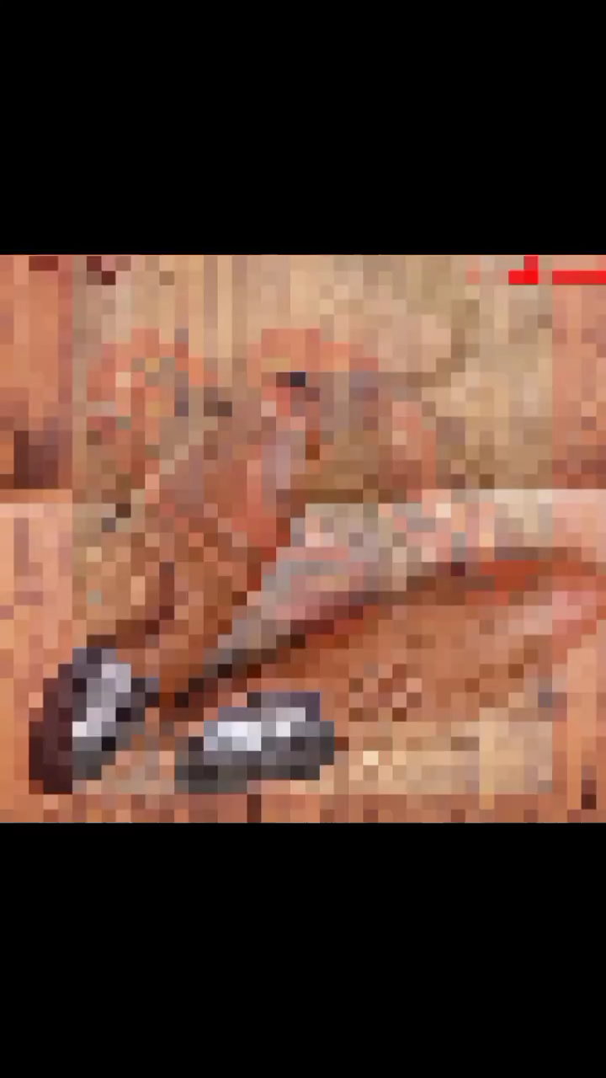
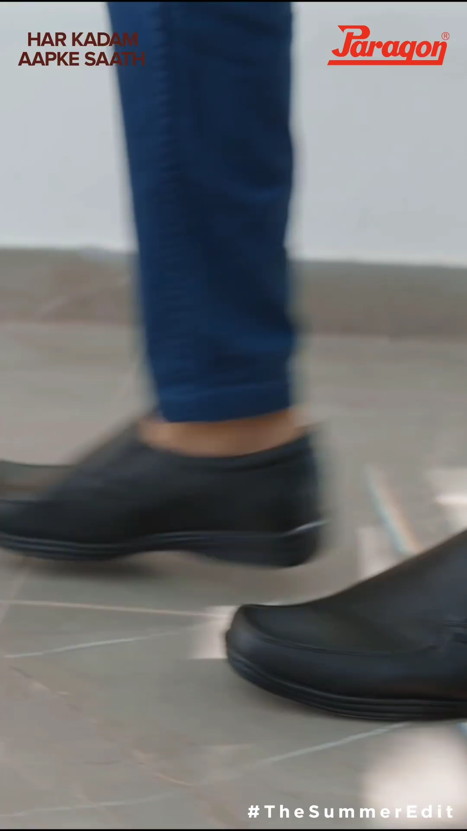
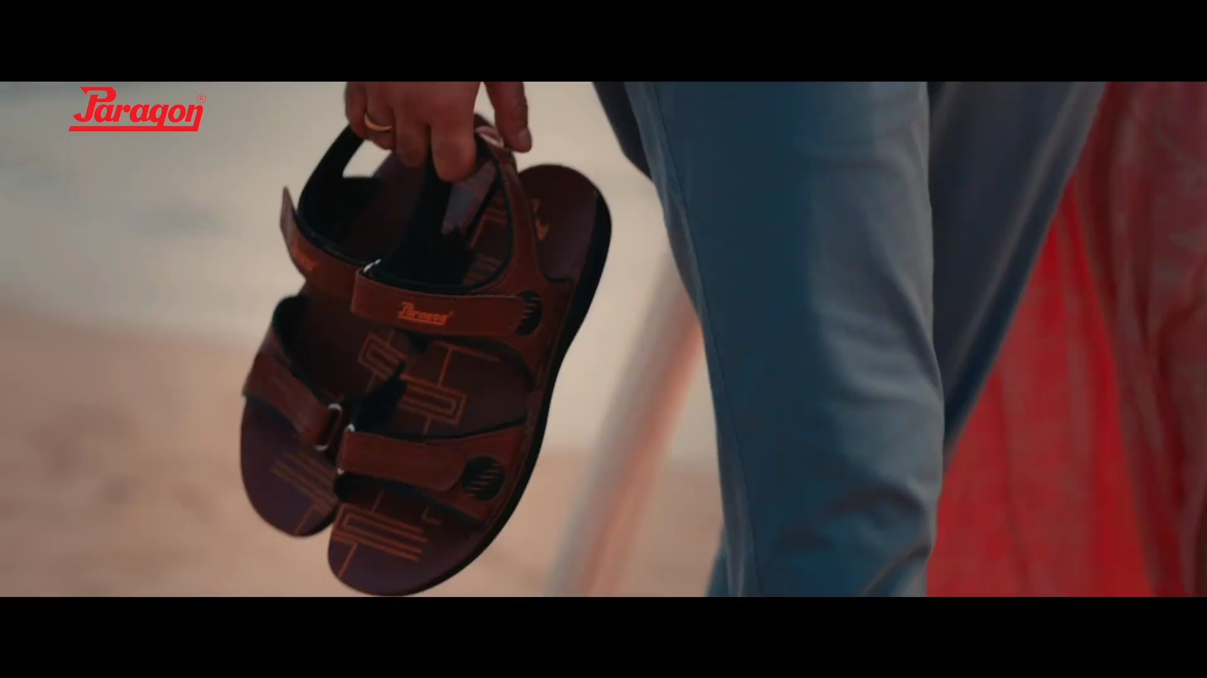
https://youtu.be/Yi_2e1HDjwU

Slide 40
Part 4: Content Creation and Curation (Post creations, Designs/Video Editing, Ad Campaigns over Social Media and Email Ideation and Creation)
Social Media Ad Campaigns
Ad Campaigns over Social Media:
INSTAGRAM AD CAMPAIGN :Instagram ads are posts that promote a business's products or services. The posts can appear in multiple ways, such as an Instagram feed, stories, or both. They can include images or video along with copy and a link to the web page of the company's choice.

Slide 41

Instagram Social Media Campaign
BRAND AWARNESS : Post content that is consistent with your brand personality. The key to increasing your brand awareness via Instagram is consistency. The content you post must be consistent with your overall brand personality. Post images and videos that are in line with the goals of your brand
Goal
To drive awareness of the extension of the brand. The goal of their Instagram campaign was based on boosting awareness and sales of their tropical flavored ‘Summer Edition’ energy drink for the Australian market.

Slide 42

Facebook Social Media Campaign

Slide 43
Facebook networks and celebrated its sponsorship and commitment to Liverpool FC. As part of the campaign, the brand shared a video message from Liverpool manager Jürgen Clop, to influencers and Liverpool fans.
Key takeaway
Facebook networks can be a very powerful way to engage a captive audience. By sponsoring Liverpool, Carlsberg improved its brand awareness and drove significant traffic to its website. This type of collaboration can be very effective in keeping a brand front of mind long after the campaign ends.
Other successful Facebook campaigns
TVibes
Slack
BRAND AWARNESS : Build awareness of your brand and business through ads on Facebook and Instagram today. The awareness objective can help people remember seeing your ads. Try it on your ad. Target The Right Audience. Build Brand Awareness. Promote your App.

Slide 44
Key Takeaway
There’s a big market for campaigns launched on social media, and the power Instagram has in driving engaged users is significant. In order to leverage Instagram to grow your customer base, you need to understand customer journeys within and across social networks so you can use them too.
Other successful Instagram campaigns
Barry’s Boot camp
Adidas Originals
TWITTER SOCIAL MEDIA CAMPAIGIN
Twitter is the answer to the question what are you doing now. It always you to creat a text like message of up to 140 characters through a pc or on your phone and send it to your followers. It’s a mix of business and social. You could be a at home communicating what your are doing or in work.

Slide 45

BRAND AWARNESS OF TWITTER : March 2022, about 23% of U.S. social media users had heard about Twitter in the media, on social media, or in advertising over the past four weeks. Of the 86% who know the brand, that's 27%, meaning at the time of the survey there's some buzz around Twitter in the United States

Slide 46
Part 4: Content Creation and Curation (Post creations, Designs/Video Editing, Ad Campaigns over Social Media and Email Ideation and Creation)
For every campaign clearly define:
Advertising Goals:
Brand awareness:
Put simply, brand awareness is the measure of how memorable and recognizable a brand is to its target audience. Establishing brand awareness is a powerful marketing strategy that leads consumers to develop an instinctive preference towards a brand and its products.
Driving website traffic :
Optimize your Images. ...
Perform a regular SEO audit. ...
Test it frequently. ...
Upgrade your server.

Slide 47
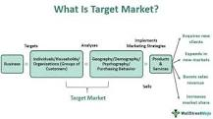
Generating leads: Lead generation for our clients includes collecting information through: Landing pages with online forms. Special offers with a specific call to action.
Audience targeting:
The common types of target markets are – geographic segmentation (location-based), demographic segmentation (population-based), psychographic segmentation (lifestyle and socio-economic-based), and behavioral segmentation.

Slide 48

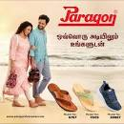
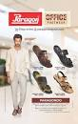
https://youtu.be/Yi_2e1HDjwU
https://youtu.be/BYvIBUAJffs
https://youtu.be/ndLsEuODaY4
.

Slide 49

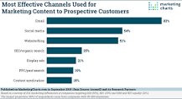
Part 4: Content Creation and Curation (Post creations, Designs/Video Editing, Ad Campaigns over Social Media and Email Ideation and Creation)
Email Ad Campaigns
Ad Campaigns for email marketing:
csparagonfootwear@paragonfootwear.com

Slide 50

op free providers include Gmail, Yahoo, Outlook, AOL, Zoho, Mail.Com, and ProtonMail. Email providers that are more secure than the others are ProtonMail, CounterMail, Hushmail, and Tutanota. Some webmail clients that provide paid services include Zoho, Gmail, Hushmail, and

Slide 51
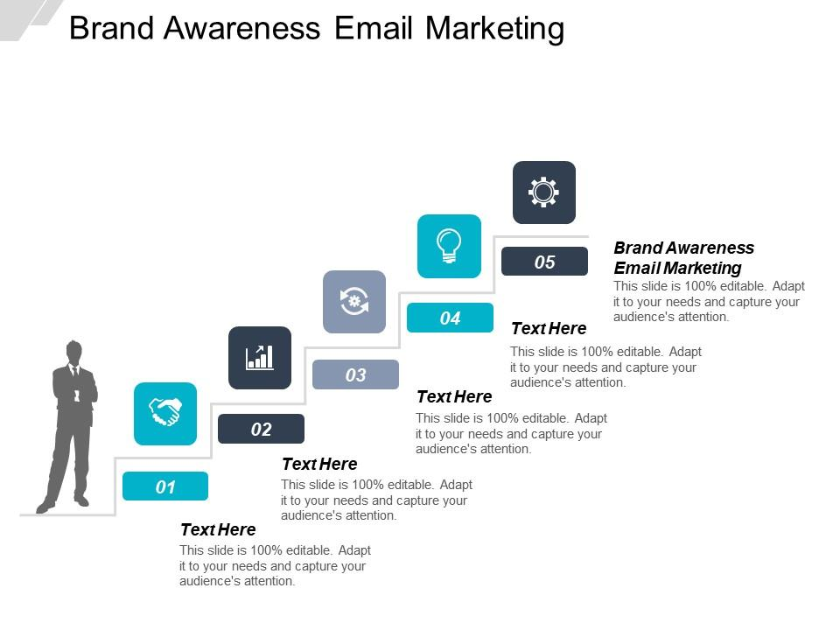

Email Ad Campaign 1 - Brand Awareness
(insert emailer image)

Slide 52
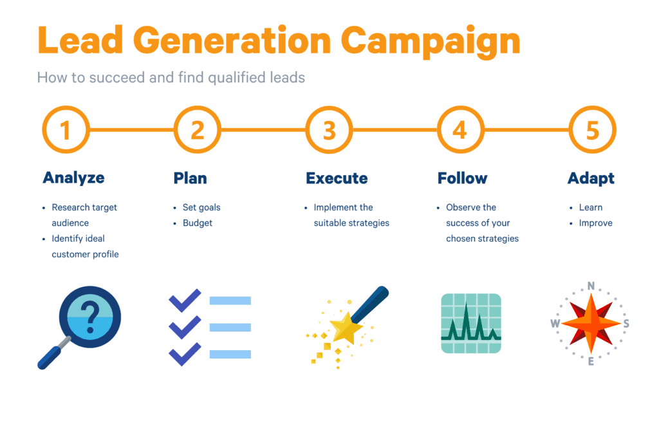
Email Ad Campaign 2 - Lead Generation
(insert emailer image)

Slide 53
Part 4: Content Creation and Curation (Post creations, Designs/Video
Editing, Ad Campaigns over Social Media and Email Ideation and Creation)
Reflect on the content creation and curation process, discussing the challenges faced and lessons learned.
Content creation and curation : shared content can be categorized into two main categories: curated, which is content gathered from trusted sources relevant to your industry and created, which is content product within your organization.
Challenges and lessons learned : first of all, I would like to thank smartbridge for giving me the first project. I played a vital role in making this project. Also learned every aspect of digital marketing in 3 months internship. During this project, I faced many challenges. At first I did not understand what to do on that topic. Then our mentor give us a suggestion. Through this project the aspects of day to operation of a company were learned. In the end, our entire team learned lesson and successfully completed our project.

Slide 54
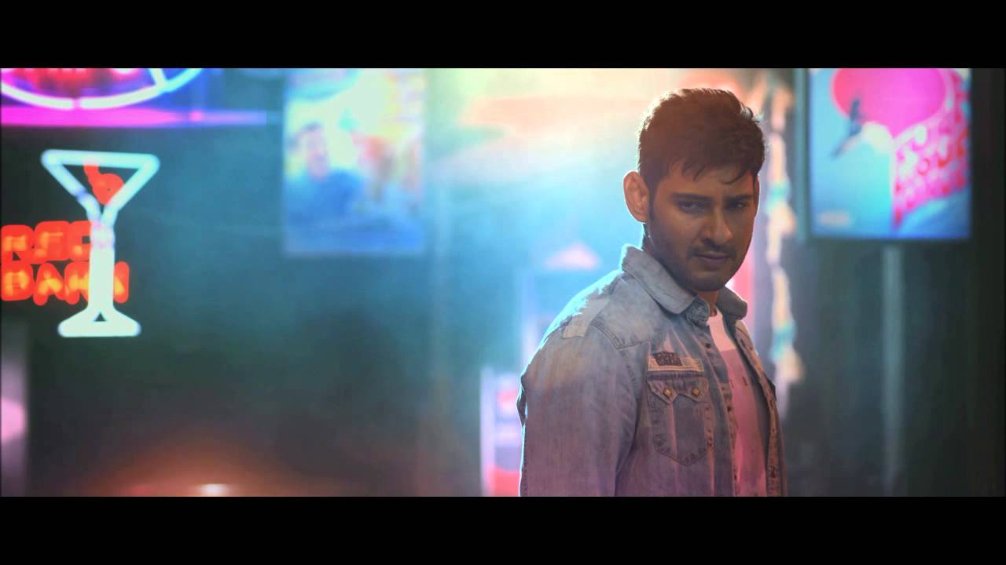
https://www.instagram.com/reel/CuYw_jmhHV9/?igshid=MzRlODBiNWFlZA==
https://www.instagram.com/reel/CrQ5WSKAWvf/?igshid=MzRlODBiNWFlZA==

Slide 55
THANK YOU

